Slide 1
One idea per slide. The blue box is where to look; the black boxes say what it means.
Did the cues change how the regions talk?
Precon1 → Precon4 · 8 rats · theta and gamma coherence
Shahriar · 23 October 2026
Notes:
From Jarvis, tabs 8 and 9 (the Monolith page). Every number on these slides is the tab's own.

Slide 2
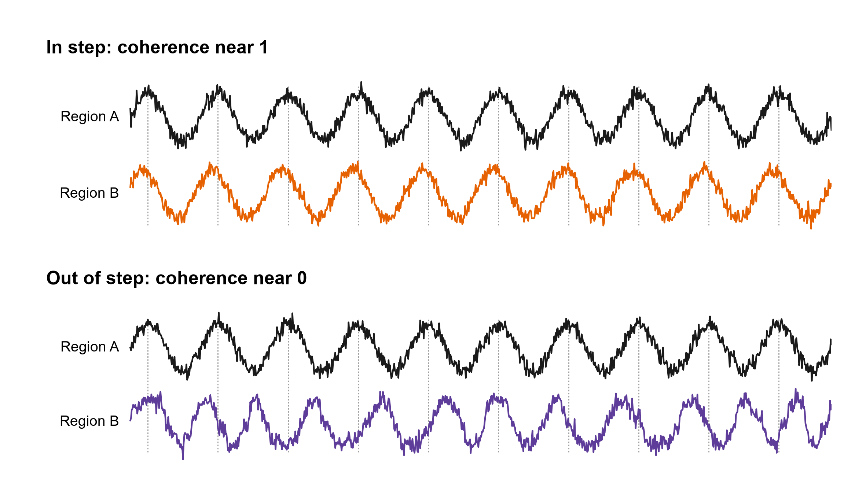
How to read this deck
One idea per slide. The blue box is where to look; the black boxes say what it means.
Coherence: how much two regions’ rhythms rise and fall together. In step, it is near 1.
Notes:
The newest note is the big red one; older ones shrink and stay on the right until the topic ends.

Slide 3
What was measured
Coherence: how much two regions’ rhythms rise and fall together. In step, it is near 1.
One idea per slide. The blue box is where to look; the black boxes say what it means.
When B’s timing drifts against A’s, it is near 0. In step, B’s peaks keep the same distance from A’s (the dotted lines).
Notes:
Coherence is computed the way Dickson et al. 2022 and Jeremy’s MATLAB do it (mscohere).

Slide 4
What was measured
Coherence: how much two regions’ rhythms rise and fall together. In step, it is near 1.
When B’s timing drifts against A’s, it is near 0. In step, B’s peaks keep the same distance from A’s (the dotted lines).
Two rhythms, as in Joe’s proposal: theta (5–12 Hz) and gamma (30–90 Hz), between every pair of 12 regions. 44 pairs had at least 4 rats on both days.

Slide 5
What was measured
Coherence: how much two regions’ rhythms rise and fall together. In step, it is near 1.
Each trial: a baseline before cue 1, then cue 1 and cue 2.
When B’s timing drifts against A’s, it is near 0. In step, B’s peaks keep the same distance from A’s (the dotted lines).
Two rhythms, as in Joe’s proposal: theta (5–12 Hz) and gamma (30–90 Hz), between every pair of 12 regions. 44 pairs had at least 4 rats on both days.

Slide 6
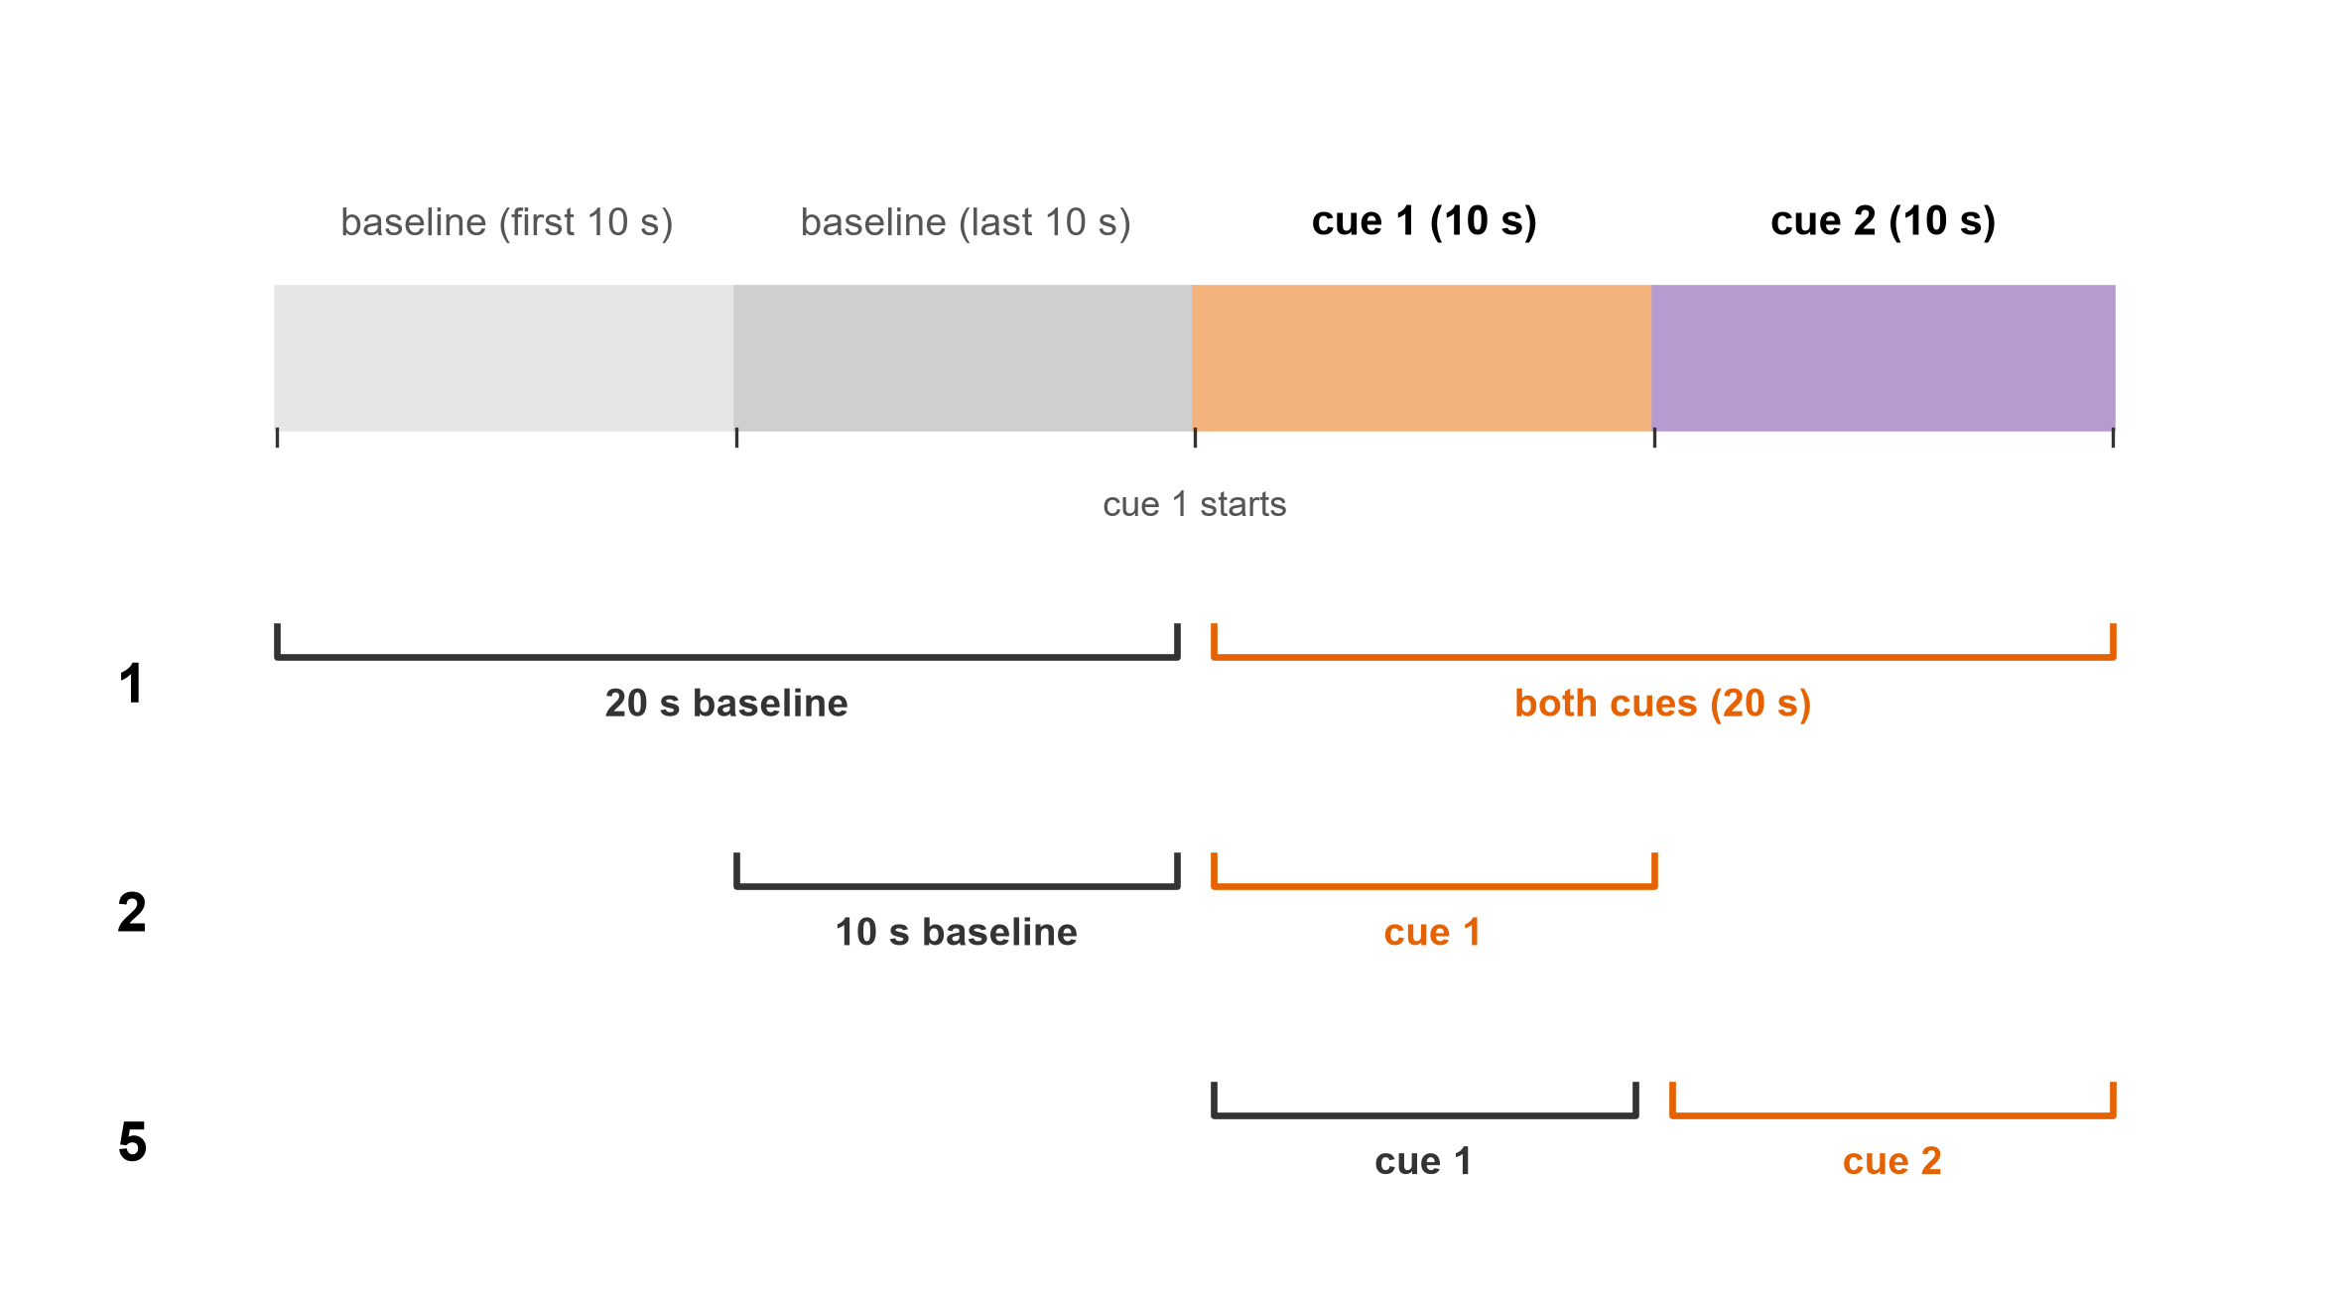
What was measured
Each trial: a baseline before cue 1, then cue 1 and cue 2.
Coherence: how much two regions’ rhythms rise and fall together. In step, it is near 1.
Comparison 1: the 20 s baseline against both cues (20 s).
When B’s timing drifts against A’s, it is near 0. In step, B’s peaks keep the same distance from A’s (the dotted lines).
Two rhythms, as in Joe’s proposal: theta (5–12 Hz) and gamma (30–90 Hz), between every pair of 12 regions. 44 pairs had at least 4 rats on both days.

Slide 7
What was measured
Each trial: a baseline before cue 1, then cue 1 and cue 2.
Comparison 1: the 20 s baseline against both cues (20 s).
Comparison 2: the 10 s baseline against cue 1.

Slide 8
What was measured
Each trial: a baseline before cue 1, then cue 1 and cue 2.
Comparison 1: the 20 s baseline against both cues (20 s).
Comparison 2: the 10 s baseline against cue 1.
Comparison 5: cue 1 against cue 2, on every trial whatever its sounds: not A against B, nor C against D.
Notes:
Coherence in each window is the mean over the session’s trials (12 to 16 a session), per rat and day.

Slide 9
What was measured
Each trial: a baseline before cue 1, then cue 1 and cue 2.
The question: did the cues’ effect on coherence change from Precon1 to Precon4?
Comparison 1: the 20 s baseline against both cues (20 s).
Comparison 2: the 10 s baseline against cue 1.
Comparison 5: cue 1 against cue 2, on every trial whatever its sounds: not A against B, nor C against D.
Notes:
Pooled over the four sounds, so the comparison is first cue against second cue, agnostic of pair identity.

Slide 10
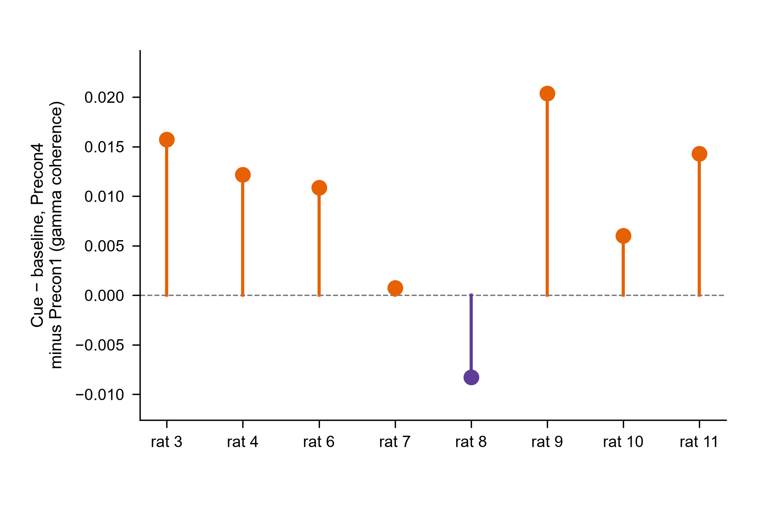
What was measured
The question: did the cues’ effect on coherence change from Precon1 to Precon4?
Each trial: a baseline before cue 1, then cue 1 and cue 2.
Comparison 1: the 20 s baseline against both cues (20 s).
Each dot is one rat (comparison 1, gamma): its cue effect (cue − baseline) on Precon4, minus its cue effect on Precon1, averaged over its pairs. 7 of 8 are above 0.
Comparison 2: the 10 s baseline against cue 1.
Comparison 5: cue 1 against cue 2, on every trial whatever its sounds: not A against B, nor C against D.

Slide 11
What was measured
The question: did the cues’ effect on coherence change from Precon1 to Precon4?
12 comparisons, each in theta and gamma. Blue: unlikely to be chance (P < 0.05). Orange diamond: a check that lit. Hollow: not clear of chance, which is not the same as no change.
Each dot is one rat (comparison 1, gamma): its cue effect (cue − baseline) on Precon4, minus its cue effect on Precon1, averaged over its pairs. 7 of 8 are above 0.
Notes:
Per rat: the mean over its pairs of (Precon4 cue − baseline) − (Precon1 cue − baseline). A one-sample t-test of these 8 numbers: t(7) = 2.77, P = 0.028.

Slide 12
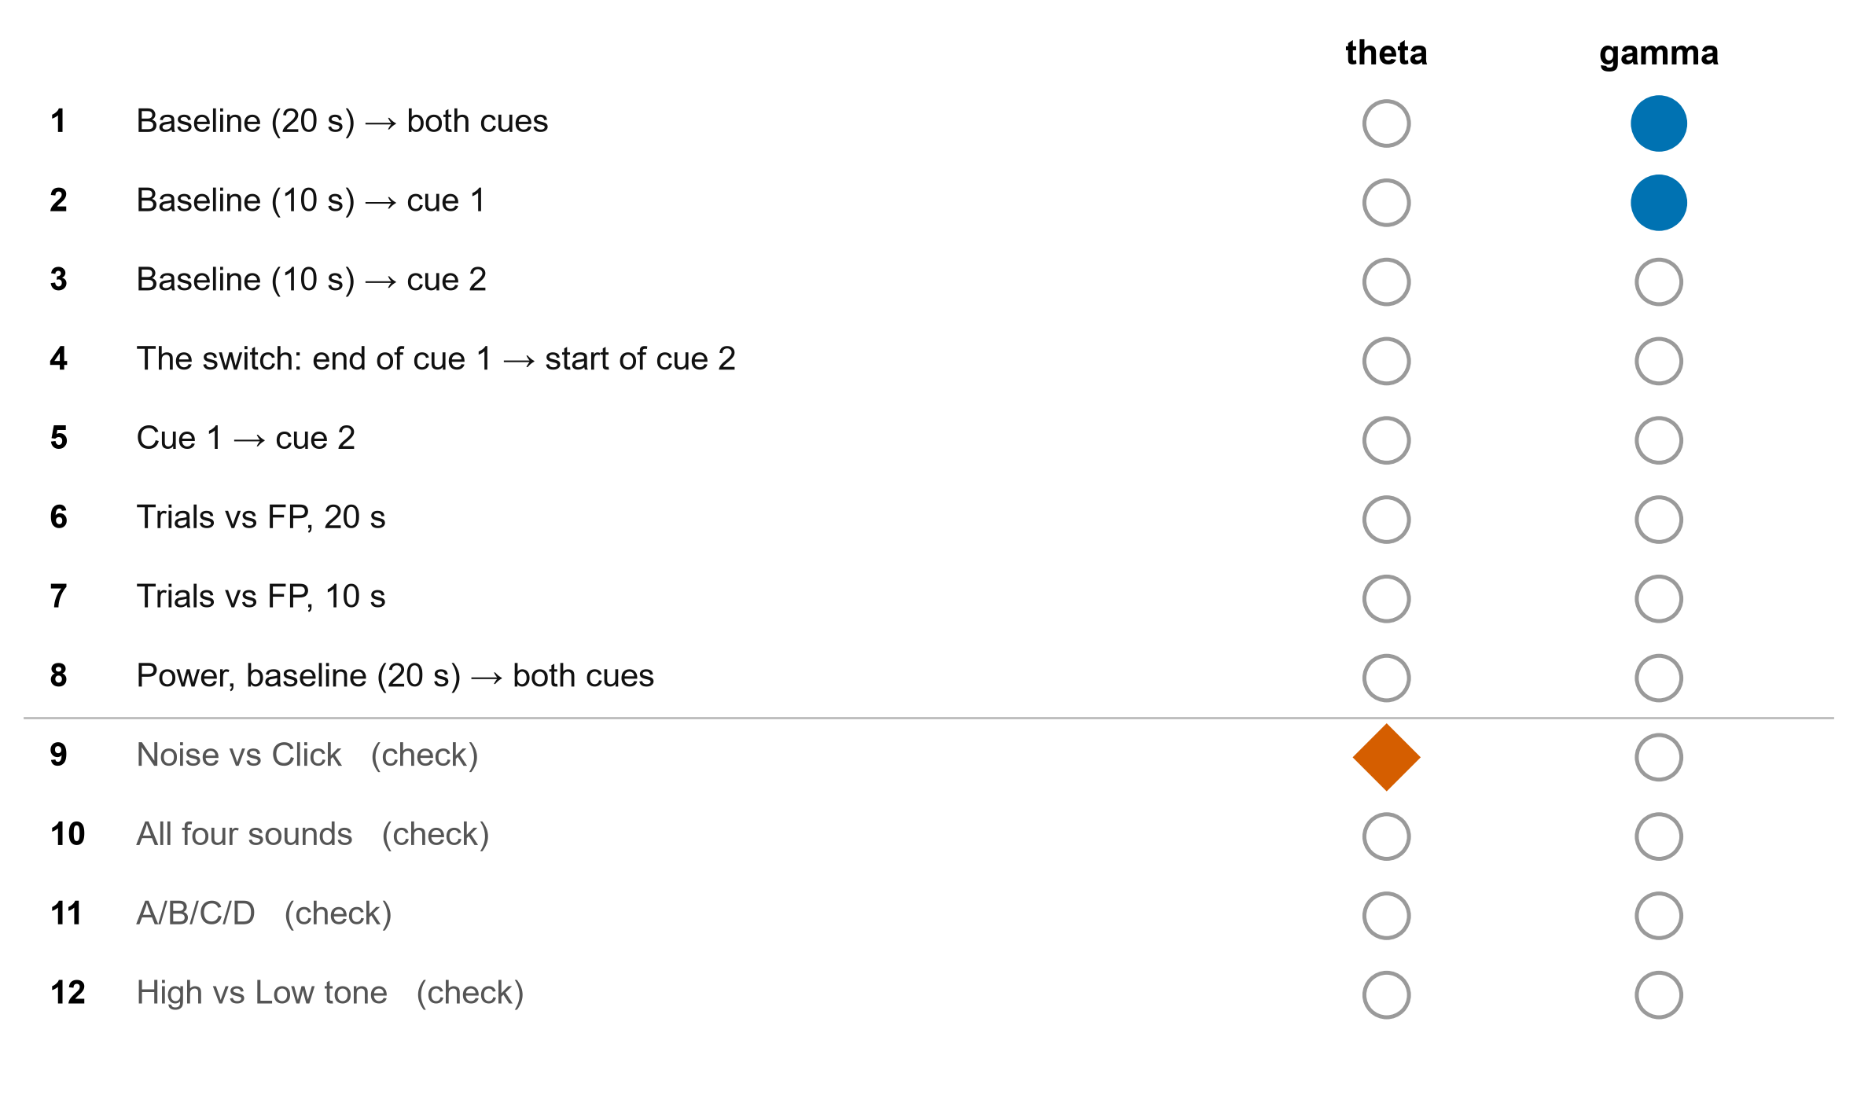
Tab 8: what lit up
12 comparisons, each in theta and gamma. Blue: unlikely to be chance (P < 0.05). Orange diamond: a check that lit. Hollow: not clear of chance, which is not the same as no change.
The question: did the cues’ effect on coherence change from Precon1 to Precon4?
Each dot is one rat (comparison 1, gamma): its cue effect (cue − baseline) on Precon4, minus its cue effect on Precon1, averaged over its pairs. 7 of 8 are above 0.
Two lit, both in gamma: comparison 1 (P = 0.017, 7 of 8 rats the same way) and comparison 2 (P = 0.035, 6 of 8).
Notes:
The lights are drawn in colours that colour-blind readers tell apart, with a shape for each state as well.

Slide 13
Tab 8: what lit up
12 comparisons, each in theta and gamma. Blue: unlikely to be chance (P < 0.05). Orange diamond: a check that lit. Hollow: not clear of chance, which is not the same as no change.
Two lit, both in gamma: comparison 1 (P = 0.017, 7 of 8 rats the same way) and comparison 2 (P = 0.035, 6 of 8).
One check lit too: Noise vs Click in theta (P = 0.039). The checks were expected to stay dark: worth a look, not a finding.
Notes:
Mixed model, rat as the unit, Day × Phase: comparison 1 F(1, 7) = 9.57, P = 0.017; comparison 2 F(1, 7) = 6.83, P = 0.035.

Slide 14
Tab 8: what lit up
12 comparisons, each in theta and gamma. Blue: unlikely to be chance (P < 0.05). Orange diamond: a check that lit. Hollow: not clear of chance, which is not the same as no change.
Two lit, both in gamma: comparison 1 (P = 0.017, 7 of 8 rats the same way) and comparison 2 (P = 0.035, 6 of 8).
One check lit too: Noise vs Click in theta (P = 0.039). The checks were expected to stay dark: worth a look, not a finding.
Nothing is corrected across the 24 lights, and each has two ways to pass. If nothing had changed anywhere, about 2 would light by chance; 3 lit.

Slide 15
Tab 8: what lit up
12 comparisons, each in theta and gamma. Blue: unlikely to be chance (P < 0.05). Orange diamond: a check that lit. Hollow: not clear of chance, which is not the same as no change.
Two lit, both in gamma: comparison 1 (P = 0.017, 7 of 8 rats the same way) and comparison 2 (P = 0.035, 6 of 8).
One check lit too: Noise vs Click in theta (P = 0.039). The checks were expected to stay dark: worth a look, not a finding.
Nothing is corrected across the 24 lights, and each has two ways to pass. If nothing had changed anywhere, about 2 would light by chance; 3 lit.
Notes:
A light passes if either its Day × factor term or its Day × factor × Pair term has P < 0.05: about 24 × (1 − 0.95²) ≈ 2.3 expected by chance alone; 3 lit.

Slide 16
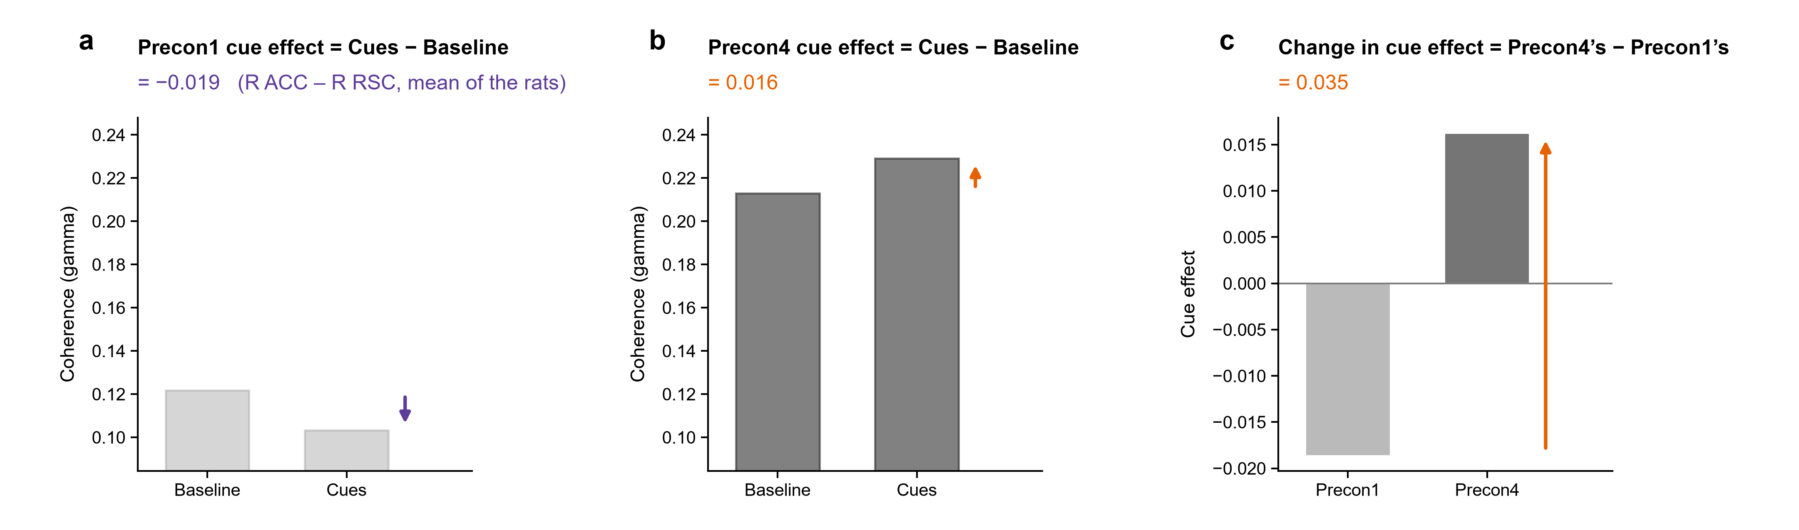
One pair, R ACC – R RSC, comparison 1 in gamma. The Precon1 cue effect: cues minus baseline on Precon1, -0.019.
12 comparisons, each in theta and gamma. Blue: unlikely to be chance (P < 0.05). Orange diamond: a check that lit. Hollow: not clear of chance, which is not the same as no change.
Figure S1
How each row of a ring is made, on one pair
Two lit, both in gamma: comparison 1 (P = 0.017, 7 of 8 rats the same way) and comparison 2 (P = 0.035, 6 of 8).
One check lit too: Noise vs Click in theta (P = 0.039). The checks were expected to stay dark: worth a look, not a finding.
Nothing is corrected across the 24 lights, and each has two ways to pass. If nothing had changed anywhere, about 2 would light by chance; 3 lit.
Notes:
How each row of the ring figures is made. Shown for one pair, R ACC – R RSC (comparison 1, gamma coherence; the pair whose change is largest), each bar the mean over the rats. a, the Precon1 cue effect: the cue window's coherence minus the baseline's, on Precon1 (a–c of a ring figure). b, the Precon4 cue effect, the same on Precon4 (d–f). c, the change in cue effect: Precon4's minus Precon1's (g–i), the number tab 8's light tests. Orange arrows: up; purple: down. A ring draws this for every pair at once, each line's width the size of its number.

Slide 17
Figure S1 · what a row is
One pair, R ACC – R RSC, comparison 1 in gamma. The Precon1 cue effect: cues minus baseline on Precon1, -0.019.
The Precon4 cue effect: the same on Precon4, +0.016.

Slide 18
Figure S1 · what a row is
One pair, R ACC – R RSC, comparison 1 in gamma. The Precon1 cue effect: cues minus baseline on Precon1, -0.019.
The Precon4 cue effect: the same on Precon4, +0.016.
The change in cue effect: Precon4’s minus Precon1’s, +0.035. This is what tab 8’s light tested.

Slide 19
Figure S1 · what a row is
One pair, R ACC – R RSC, comparison 1 in gamma. The Precon1 cue effect: cues minus baseline on Precon1, -0.019.
The Precon4 cue effect: the same on Precon4, +0.016.
The change in cue effect: Precon4’s minus Precon1’s, +0.035. This is what tab 8’s light tested.
A ring draws these three numbers for every pair at once: its three rows.

Slide 20
Figure S1 · what a row is
One pair, R ACC – R RSC, comparison 1 in gamma. The Precon1 cue effect: cues minus baseline on Precon1, -0.019.
The Precon4 cue effect: the same on Precon4, +0.016.
The change in cue effect: Precon4’s minus Precon1’s, +0.035. This is what tab 8’s light tested.
A ring draws these three numbers for every pair at once: its three rows.

Slide 21
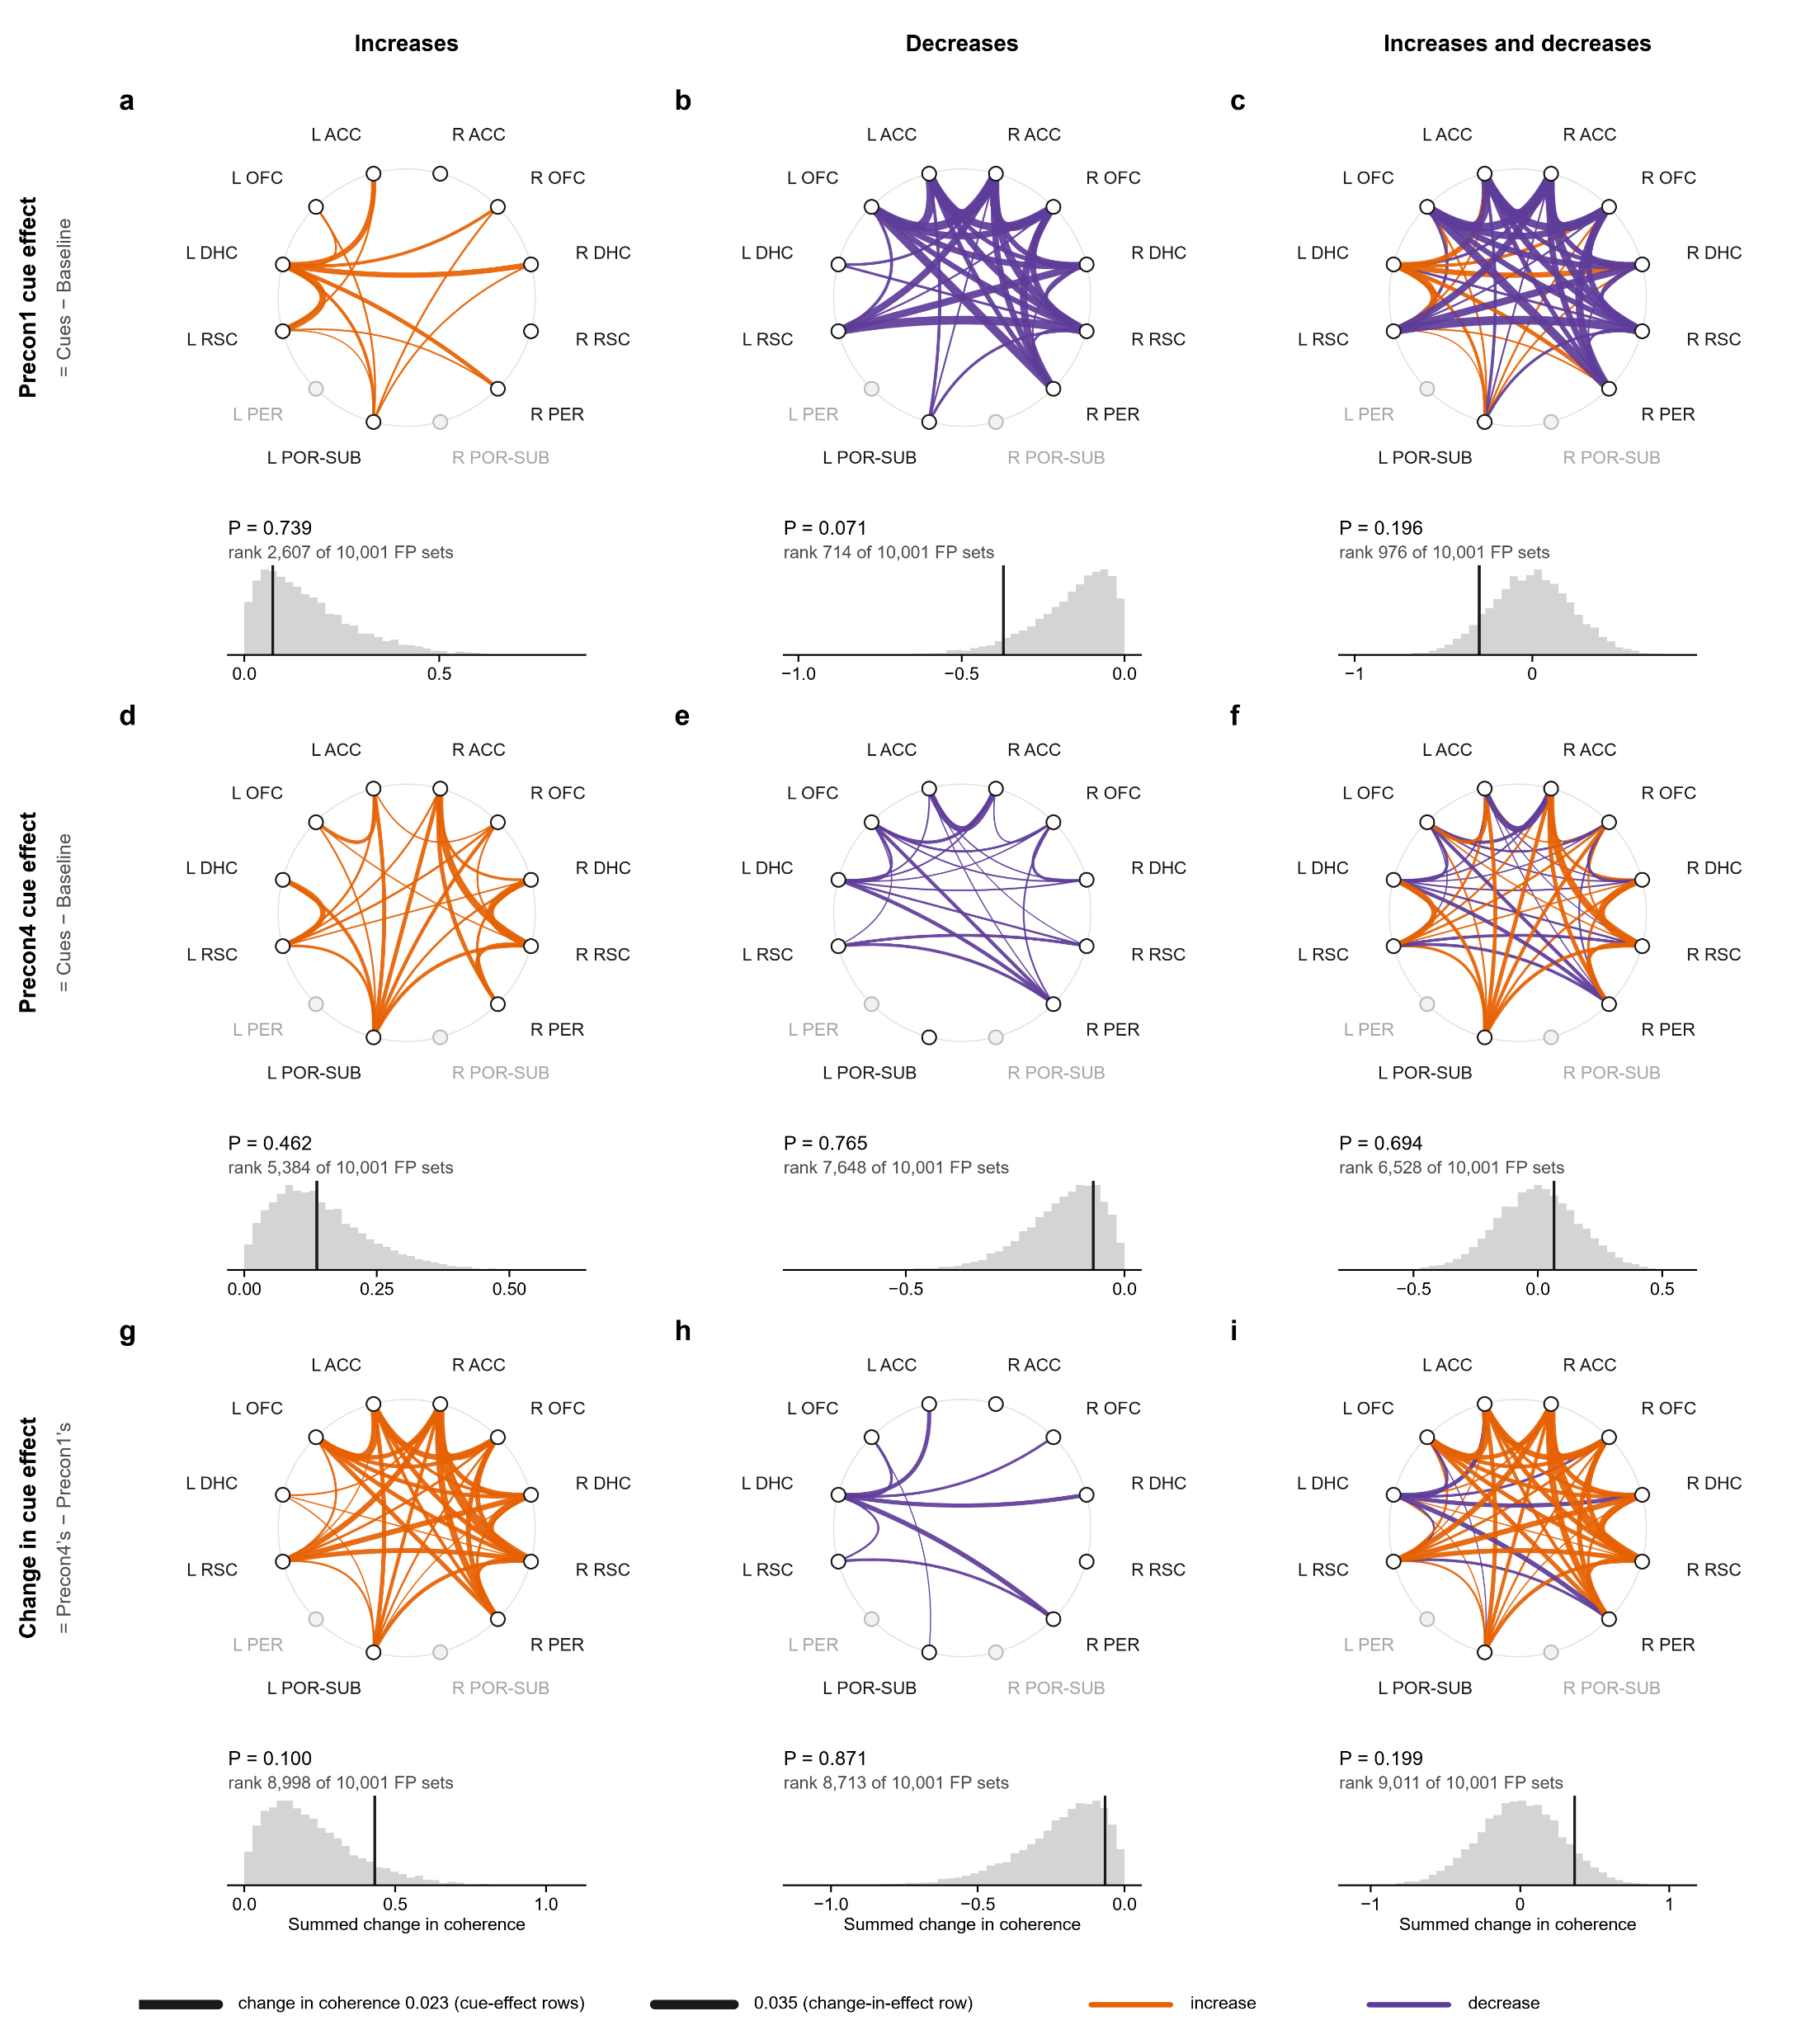
Every ring is the same 12 regions. Each line is one pair, 44 pairs in all. Grey dots: regions no pair reached with 4 rats.
One pair, R ACC – R RSC, comparison 1 in gamma. The Precon1 cue effect: cues minus baseline on Precon1, -0.019.
The Precon4 cue effect: the same on Precon4, +0.016.
Figure 2
Comparison 1, baseline → both cues, gamma: the whole network
The change in cue effect: Precon4’s minus Precon1’s, +0.035. This is what tab 8’s light tested.
A ring draws these three numbers for every pair at once: its three rows.

Slide 22
Figure 2 · baseline → both cues · gamma
Every ring is the same 12 regions. Each line is one pair, 44 pairs in all. Grey dots: regions no pair reached with 4 rats.
A line’s width is that pair’s cue effect, averaged over the rats. Orange: the cues raised coherence.
Notes:
Baseline (20 s) → both cues, gamma 30–90 Hz: the connectome of the change from Baseline (20 s) to Cue 1 + Cue 2 (20 s). a–c, the Precon1 cue effect (Cues − Baseline, on Precon1); d–f, the Precon4 cue effect; g–i, the change in cue effect (Precon4’s minus Precon1’s). Each ring holds the 12 regions (open, a region no pair reaches with at least 4 rats); each edge is one of the 44 pairs tested, curving toward the centre, its width the mean change in coherence from Baseline (20 s) to Cue 1 + Cue 2 (20 s) over the rats (Dickson 2022: 59–61 Hz notch, hanning(1024), 512 overlap, 2,048 points, averaged over 30–90 Hz without 59–61 Hz), orange for an increase and purple for a decrease. Left column, the increases; middle, the decreases; right, both. Under each ring, its statistic (the summed increases, the summed decreases, or the sum of all) against 10,000 sets of fake trials from the same rats’ FP1 and FP2 recordings, where there were no cues: a fake cue onset every 10 s of FP, the trial’s own windows round it, measured as a trial’s are; in each set every session gets as many fake trials as it had real ones, drawn at random with replacement, each with its two windows in random order (with no cue, either can stand for it) and losing the windows the matching real trial lost to clipping, and its change is made as the real one is. The vertical line is the observed value, with its rank among the sets and its P (increases one-sided upward, decreases downward, both two-sided; *P < 0.05, **P < 0.01, ***P < 0.001; uncorrected). n = 8 rats, 12–16 trials per session. Significant: none.

Slide 23

Figure 2 · baseline → both cues · gamma
Every ring is the same 12 regions. Each line is one pair, 44 pairs in all. Grey dots: regions no pair reached with 4 rats.
A line’s width is that pair’s cue effect, averaged over the rats. Orange: the cues raised coherence.
Purple: they lowered it.

Slide 24
Figure 2 · baseline → both cues · gamma
Every ring is the same 12 regions. Each line is one pair, 44 pairs in all. Grey dots: regions no pair reached with 4 rats.
A line’s width is that pair’s cue effect, averaged over the rats. Orange: the cues raised coherence.
Purple: they lowered it.
Top row: the Precon1 cue effect (Cues − Baseline). The cues lowered gamma coherence in 31 of the 44 pairs.

Slide 25
Figure 2 · baseline → both cues · gamma
Every ring is the same 12 regions. Each line is one pair, 44 pairs in all. Grey dots: regions no pair reached with 4 rats.
A line’s width is that pair’s cue effect, averaged over the rats. Orange: the cues raised coherence.
Purple: they lowered it.
Top row: the Precon1 cue effect (Cues − Baseline). The cues lowered gamma coherence in 31 of the 44 pairs.
Middle row: the Precon4 cue effect. About even: 23 pairs up, 21 down.

Slide 26
Figure 2 · baseline → both cues · gamma
Every ring is the same 12 regions. Each line is one pair, 44 pairs in all. Grey dots: regions no pair reached with 4 rats.
A line’s width is that pair’s cue effect, averaged over the rats. Orange: the cues raised coherence.
Purple: they lowered it.
Top row: the Precon1 cue effect (Cues − Baseline). The cues lowered gamma coherence in 31 of the 44 pairs.
Middle row: the Precon4 cue effect. About even: 23 pairs up, 21 down.
Bottom row: the change in cue effect, Precon4’s minus Precon1’s. This is what tab 8’s light tested.

Slide 27
Figure 2 · baseline → both cues · gamma
Every ring is the same 12 regions. Each line is one pair, 44 pairs in all. Grey dots: regions no pair reached with 4 rats.
Left column: only the lines that went up. Middle: only those that went down. Right: both.
A line’s width is that pair’s cue effect, averaged over the rats. Orange: the cues raised coherence.
Purple: they lowered it.
Top row: the Precon1 cue effect (Cues − Baseline). The cues lowered gamma coherence in 31 of the 44 pairs.
Middle row: the Precon4 cue effect. About even: 23 pairs up, 21 down.
Bottom row: the change in cue effect, Precon4’s minus Precon1’s. This is what tab 8’s light tested.

Slide 28
Figure 2 · baseline → both cues · gamma
Left column: only the lines that went up. Middle: only those that went down. Right: both.
Each ring becomes one number: its lines added up. Here the change’s increases add up to 0.43: the black line under the ring.
Every ring is the same 12 regions. Each line is one pair, 44 pairs in all. Grey dots: regions no pair reached with 4 rats.
A line’s width is that pair’s cue effect, averaged over the rats. Orange: the cues raised coherence.
Purple: they lowered it.
Top row: the Precon1 cue effect (Cues − Baseline). The cues lowered gamma coherence in 31 of the 44 pairs.
Middle row: the Precon4 cue effect. About even: 23 pairs up, 21 down.
Bottom row: the change in cue effect, Precon4’s minus Precon1’s. This is what tab 8’s light tested.

Slide 29

Figure 2 · baseline → both cues · gamma
Each ring becomes one number: its lines added up. Here the change’s increases add up to 0.43: the black line under the ring.
Left column: only the lines that went up. Middle: only those that went down. Right: both.
Test 1, FP: the same rats in FP1 and FP2, with no cues. Fake trials at random moments, measured as real ones are; 10,000 sets, each session as many as it had real trials. Each set’s sum is the grey hill.

Slide 30
Figure 2 · baseline → both cues · gamma
Each ring becomes one number: its lines added up. Here the change’s increases add up to 0.43: the black line under the ring.
Test 1, FP: the same rats in FP1 and FP2, with no cues. Fake trials at random moments, measured as real ones are; 10,000 sets, each session as many as it had real trials. Each set’s sum is the grey hill.
The black line is the real sum. Against FP: P = 0.100. It does not stand out of what the rats do with no cues.
Notes:
A fake cue onset every 10 s of FP1 and FP2 (1,017 fake trials in all), the trial's own windows round it, measured with the same wires, clipping and measures; each set draws each session's fake trials at random, with replacement, losing the windows its real trials lost.

Slide 31
Figure 2 · baseline → both cues · gamma
Each ring becomes one number: its lines added up. Here the change’s increases add up to 0.43: the black line under the ring.
Test 2, the shuffles (P, a toggle on tab 9): in every session, each trial’s baseline and cue swapped at random, 10,000 times. Single trials vary a lot, so the hill is wide: P = 0.085.
Test 1, FP: the same rats in FP1 and FP2, with no cues. Fake trials at random moments, measured as real ones are; 10,000 sets, each session as many as it had real trials. Each set’s sum is the grey hill.
The black line is the real sum. Against FP: P = 0.100. It does not stand out of what the rats do with no cues.
Notes:
Rank 8998 of 10001.

Slide 32
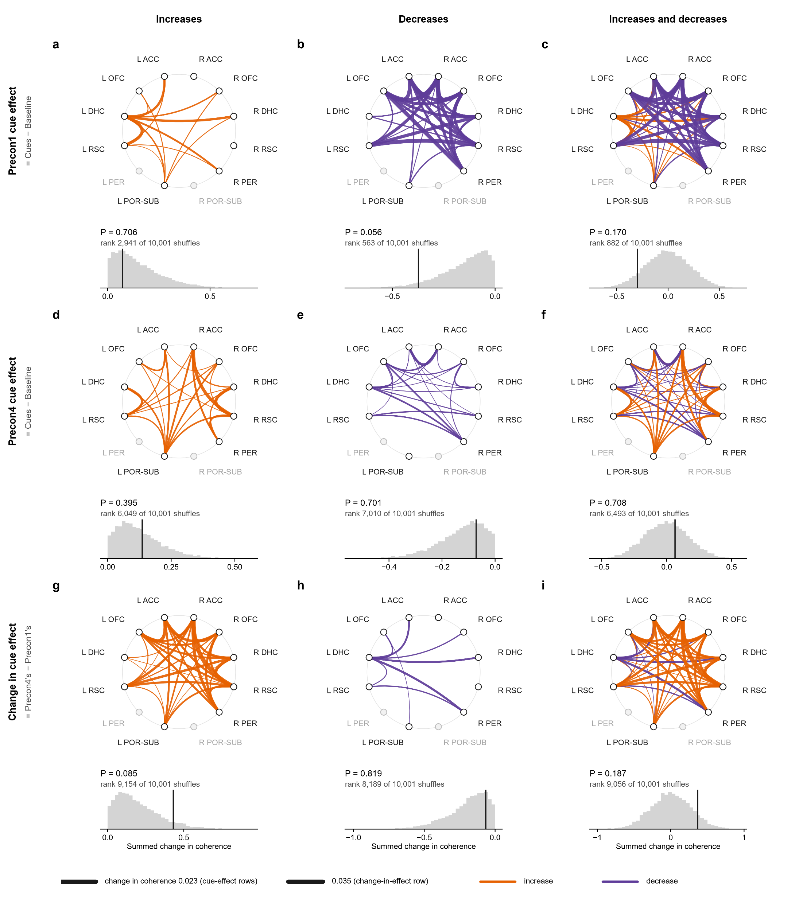
Figure 2 · baseline → both cues · gamma
Test 2, the shuffles (P, a toggle on tab 9): in every session, each trial’s baseline and cue swapped at random, 10,000 times. Single trials vary a lot, so the hill is wide: P = 0.085.
Test 3, the rats’ flips (T): if the cues’ effect were the same on both days, each rat’s change could as well point the other way. Flip the signs every way (256 for 8 rats): only 3 sums reach the real one, P = 0.012.
Each ring becomes one number: its lines added up. Here the change’s increases add up to 0.43: the black line under the ring.
Test 1, FP: the same rats in FP1 and FP2, with no cues. Fake trials at random moments, measured as real ones are; 10,000 sets, each session as many as it had real trials. Each set’s sum is the grey hill.
The black line is the real sum. Against FP: P = 0.100. It does not stand out of what the rats do with no cues.
Notes:
Trial-to-trial noise inside a session is about 1.7 times wider than the spread between rats.

Slide 33
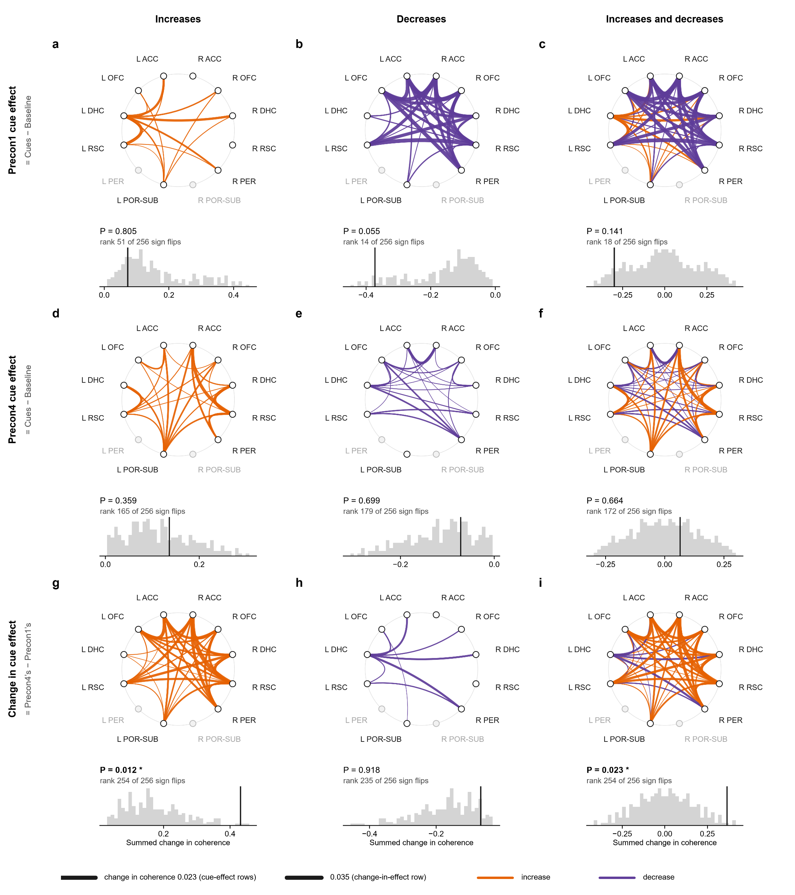
Figure 2 · baseline → both cues · gamma
Test 3, the rats’ flips (T): if the cues’ effect were the same on both days, each rat’s change could as well point the other way. Flip the signs every way (256 for 8 rats): only 3 sums reach the real one, P = 0.012.
Test 2, the shuffles (P, a toggle on tab 9): in every session, each trial’s baseline and cue swapped at random, 10,000 times. Single trials vary a lot, so the hill is wide: P = 0.085.
Ups and downs together: FP P = 0.199, shuffles P = 0.187, rats’ flips P = 0.023.
Notes:
Exact sign-flip test, the rat as the unit (as the mixed model behind tab 8's light). P is the share of the 256 patterns at least as extreme, the real one included; rank 254.

Slide 34
Figure 2 · baseline → both cues · gamma
Test 3, the rats’ flips (T): if the cues’ effect were the same on both days, each rat’s change could as well point the other way. Flip the signs every way (256 for 8 rats): only 3 sums reach the real one, P = 0.012.
Ups and downs together: FP P = 0.199, shuffles P = 0.187, rats’ flips P = 0.023.
Neither day’s cue effect passes a test on its own (Precon1 P = 0.055 at best, Precon4 P = 0.359): it is the change between them.

Slide 35

Figure 2 · baseline → both cues · gamma
Test 3, the rats’ flips (T): if the cues’ effect were the same on both days, each rat’s change could as well point the other way. Flip the signs every way (256 for 8 rats): only 3 sums reach the real one, P = 0.012.
So: the increases pass only the rats’ flips, the test that matches tab 8’s light; neither FP nor the shuffles confirm it. Figure 2 is a lead, not a finding.
Ups and downs together: FP P = 0.199, shuffles P = 0.187, rats’ flips P = 0.023.
Neither day’s cue effect passes a test on its own (Precon1 P = 0.055 at best, Precon4 P = 0.359): it is the change between them.

Slide 36
Figure 2 · baseline → both cues · gamma
So: the increases pass only the rats’ flips, the test that matches tab 8’s light; neither FP nor the shuffles confirm it. Figure 2 is a lead, not a finding.
Test 3, the rats’ flips (T): if the cues’ effect were the same on both days, each rat’s change could as well point the other way. Flip the signs every way (256 for 8 rats): only 3 sums reach the real one, P = 0.012.
Ups and downs together: FP P = 0.199, shuffles P = 0.187, rats’ flips P = 0.023.
Neither day’s cue effect passes a test on its own (Precon1 P = 0.055 at best, Precon4 P = 0.359): it is the change between them.

Slide 37
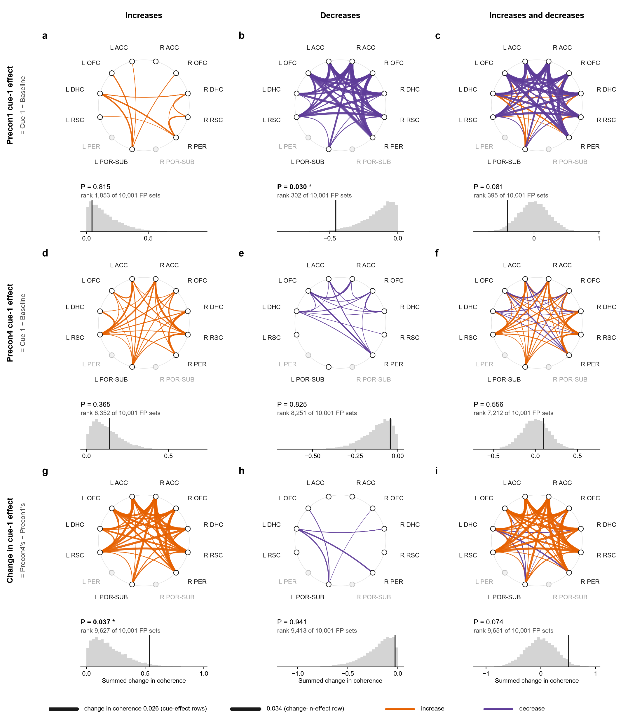
Same layout, comparison 2: the 10 s baseline against cue 1.
So: the increases pass only the rats’ flips, the test that matches tab 8’s light; neither FP nor the shuffles confirm it. Figure 2 is a lead, not a finding.
Figure 4
Comparison 2, baseline → cue 1, gamma: the whole network

Slide 38
Figure 4 · baseline → cue 1 · gamma
Same layout, comparison 2: the 10 s baseline against cue 1.
The change’s increases: FP P = 0.037, shuffles P = 0.030, rats’ flips P = 0.027. The one network result that passes every test.
Notes:
Baseline (10 s) → cue 1, gamma 30–90 Hz: the connectome of the change from Baseline (10 s) to Cue 1. a–c, the Precon1 cue-1 effect (Cue 1 − Baseline, on Precon1); d–f, the Precon4 cue-1 effect; g–i, the change in cue-1 effect (Precon4’s minus Precon1’s). Each ring holds the 12 regions (open, a region no pair reaches with at least 4 rats); each edge is one of the 44 pairs tested, curving toward the centre, its width the mean change in coherence from Baseline (10 s) to Cue 1 over the rats (Dickson 2022: 59–61 Hz notch, hanning(1024), 512 overlap, 2,048 points, averaged over 30–90 Hz without 59–61 Hz), orange for an increase and purple for a decrease. Left column, the increases; middle, the decreases; right, both. Under each ring, its statistic (the summed increases, the summed decreases, or the sum of all) against 10,000 sets of fake trials from the same rats’ FP1 and FP2 recordings, where there were no cues: a fake cue onset every 10 s of FP, the trial’s own windows round it, measured as a trial’s are; in each set every session gets as many fake trials as it had real ones, drawn at random with replacement, each with its two windows in random order (with no cue, either can stand for it) and losing the windows the matching real trial lost to clipping, and its change is made as the real one is. The vertical line is the observed value, with its rank among the sets and its P (increases one-sided upward, decreases downward, both two-sided; *P < 0.05, **P < 0.01, ***P < 0.001; uncorrected). n = 8 rats, 12–16 trials per session. Significant: Precon1 cue-1 effect, decreases: P = 0.030; Change in cue-1 effect, increases: P = 0.037.

Slide 39

Figure 4 · baseline → cue 1 · gamma
Same layout, comparison 2: the 10 s baseline against cue 1.
The change’s increases: FP P = 0.037, shuffles P = 0.030, rats’ flips P = 0.027. The one network result that passes every test.
Ups and downs together: FP P = 0.074, shuffles P = 0.058, rats’ flips P = 0.062.

Slide 40
Figure 4 · baseline → cue 1 · gamma
Same layout, comparison 2: the 10 s baseline against cue 1.
One ring splits the tests: on Precon1 alone, the decreases (FP P = 0.030, shuffles P = 0.039, rats’ flips P = 0.090). It is one day’s cue effect, not the change, so it does not answer the question.
The change’s increases: FP P = 0.037, shuffles P = 0.030, rats’ flips P = 0.027. The one network result that passes every test.
Ups and downs together: FP P = 0.074, shuffles P = 0.058, rats’ flips P = 0.062.

Slide 41
Figure 4 · baseline → cue 1 · gamma
One ring splits the tests: on Precon1 alone, the decreases (FP P = 0.030, shuffles P = 0.039, rats’ flips P = 0.090). It is one day’s cue effect, not the change, so it does not answer the question.
Same layout, comparison 2: the 10 s baseline against cue 1.
The change’s increases: FP P = 0.037, shuffles P = 0.030, rats’ flips P = 0.027. The one network result that passes every test.
Ups and downs together: FP P = 0.074, shuffles P = 0.058, rats’ flips P = 0.062.

Slide 42
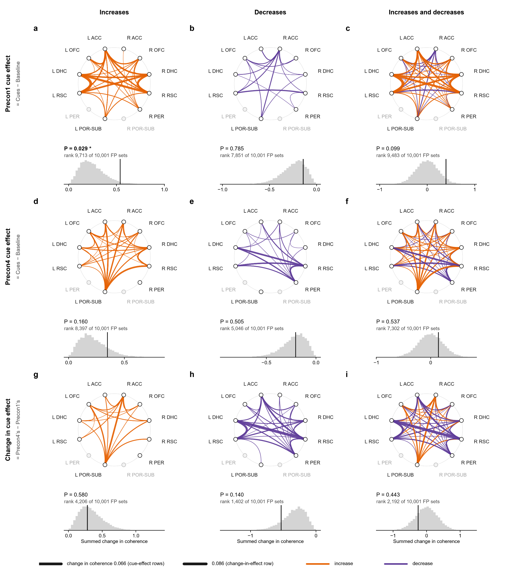
The change in cue effect passes none of its 9 tests (smallest P = 0.14): no change from Precon1 to Precon4 here.
One ring splits the tests: on Precon1 alone, the decreases (FP P = 0.030, shuffles P = 0.039, rats’ flips P = 0.090). It is one day’s cue effect, not the change, so it does not answer the question.
Figure 1
Comparison 1, baseline → both cues, theta: the whole network

Slide 43
Figure 1 · baseline → both cues · theta
The change in cue effect passes none of its 9 tests (smallest P = 0.14): no change from Precon1 to Precon4 here.
On Precon1 alone, the cue effect’s increases pass FP (P = 0.029).
Notes:
Baseline (20 s) → both cues, theta 5–12 Hz: the connectome of the change from Baseline (20 s) to Cue 1 + Cue 2 (20 s). a–c, the Precon1 cue effect (Cues − Baseline, on Precon1); d–f, the Precon4 cue effect; g–i, the change in cue effect (Precon4’s minus Precon1’s). Each ring holds the 12 regions (open, a region no pair reaches with at least 4 rats); each edge is one of the 44 pairs tested, curving toward the centre, its width the mean change in coherence from Baseline (20 s) to Cue 1 + Cue 2 (20 s) over the rats (Dickson 2022: 59–61 Hz notch, hanning(1024), 512 overlap, 2,048 points, averaged over 30–90 Hz without 59–61 Hz), orange for an increase and purple for a decrease. Left column, the increases; middle, the decreases; right, both. Under each ring, its statistic (the summed increases, the summed decreases, or the sum of all) against 10,000 sets of fake trials from the same rats’ FP1 and FP2 recordings, where there were no cues: a fake cue onset every 10 s of FP, the trial’s own windows round it, measured as a trial’s are; in each set every session gets as many fake trials as it had real ones, drawn at random with replacement, each with its two windows in random order (with no cue, either can stand for it) and losing the windows the matching real trial lost to clipping, and its change is made as the real one is. The vertical line is the observed value, with its rank among the sets and its P (increases one-sided upward, decreases downward, both two-sided; *P < 0.05, **P < 0.01, ***P < 0.001; uncorrected). n = 8 rats, 12–16 trials per session. Significant: Precon1 cue effect, increases: P = 0.029.

Slide 44
Figure 1 · baseline → both cues · theta
The change in cue effect passes none of its 9 tests (smallest P = 0.14): no change from Precon1 to Precon4 here.
On Precon1 alone, the cue effect’s increases pass FP (P = 0.029).
Notes:
One day's cue effect, not the change across days: on that day the cue moved theta coherence beyond what FP or the shuffles give.

Slide 45
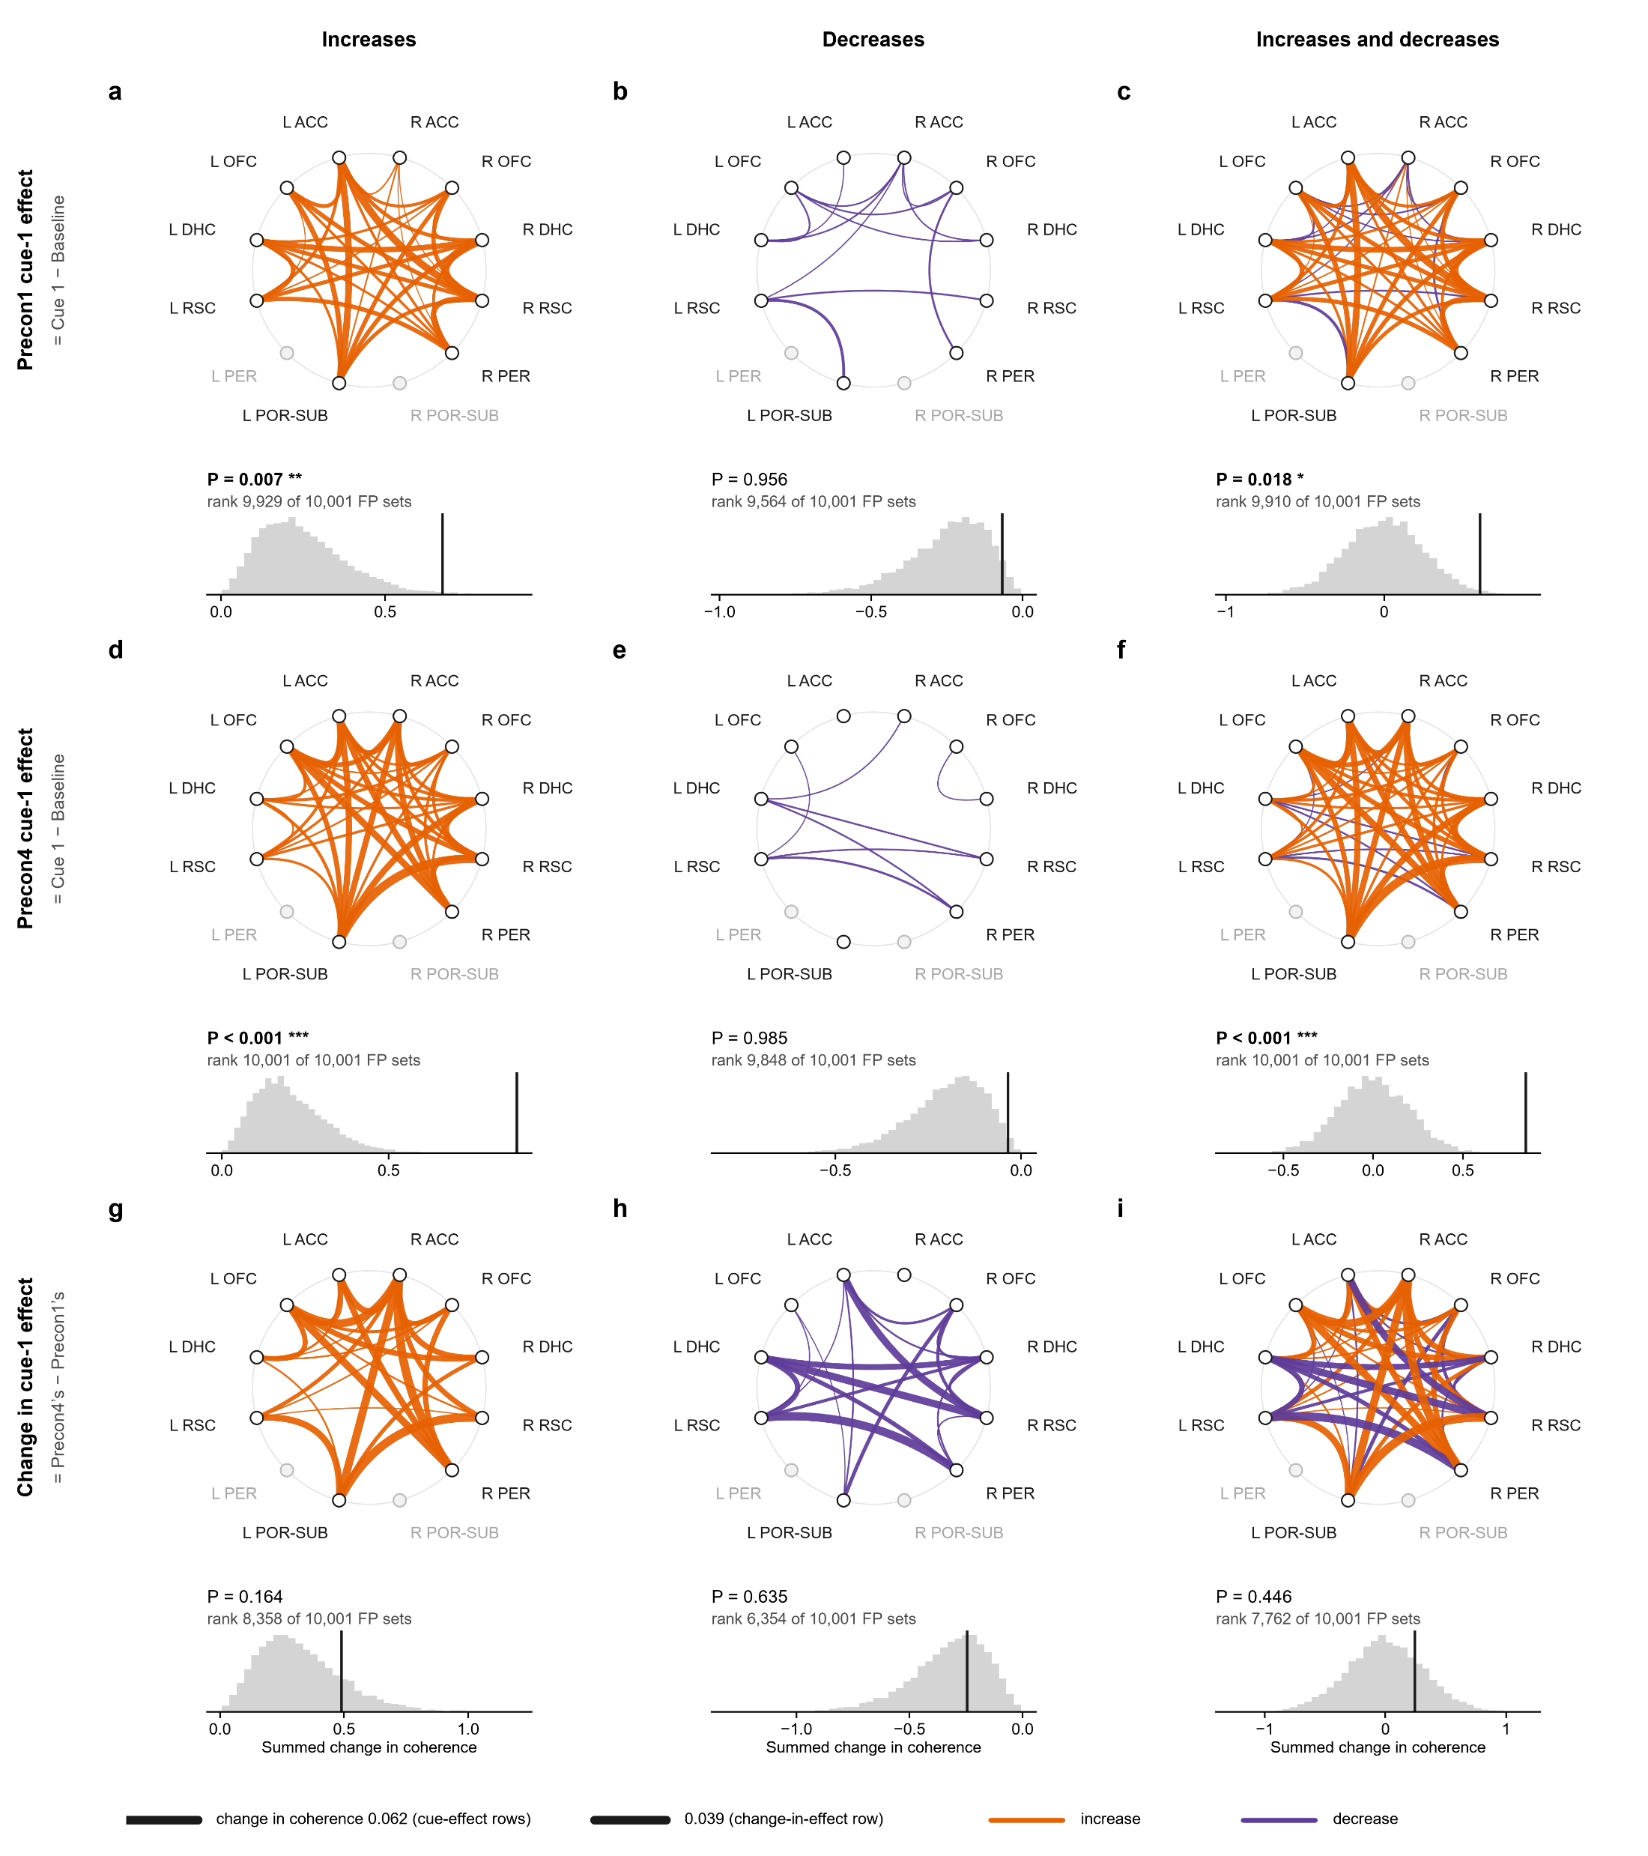
The change in cue effect passes none of its 9 tests (smallest P = 0.16): no change from Precon1 to Precon4 here.
The change in cue effect passes none of its 9 tests (smallest P = 0.14): no change from Precon1 to Precon4 here.
On Precon1 alone, the cue effect’s increases pass FP (P = 0.029).
Figure 3
Comparison 2, baseline → cue 1, theta: the whole network

Slide 46
Figure 3 · baseline → cue 1 · theta
The change in cue effect passes none of its 9 tests (smallest P = 0.16): no change from Precon1 to Precon4 here.
On Precon1 alone, the cue-1 effect’s increases pass FP (P = 0.007); the cue-1 effect’s ups and downs together pass FP (P = 0.018).
Notes:
Baseline (10 s) → cue 1, theta 5–12 Hz: the connectome of the change from Baseline (10 s) to Cue 1. a–c, the Precon1 cue-1 effect (Cue 1 − Baseline, on Precon1); d–f, the Precon4 cue-1 effect; g–i, the change in cue-1 effect (Precon4’s minus Precon1’s). Each ring holds the 12 regions (open, a region no pair reaches with at least 4 rats); each edge is one of the 44 pairs tested, curving toward the centre, its width the mean change in coherence from Baseline (10 s) to Cue 1 over the rats (Dickson 2022: 59–61 Hz notch, hanning(1024), 512 overlap, 2,048 points, averaged over 30–90 Hz without 59–61 Hz), orange for an increase and purple for a decrease. Left column, the increases; middle, the decreases; right, both. Under each ring, its statistic (the summed increases, the summed decreases, or the sum of all) against 10,000 sets of fake trials from the same rats’ FP1 and FP2 recordings, where there were no cues: a fake cue onset every 10 s of FP, the trial’s own windows round it, measured as a trial’s are; in each set every session gets as many fake trials as it had real ones, drawn at random with replacement, each with its two windows in random order (with no cue, either can stand for it) and losing the windows the matching real trial lost to clipping, and its change is made as the real one is. The vertical line is the observed value, with its rank among the sets and its P (increases one-sided upward, decreases downward, both two-sided; *P < 0.05, **P < 0.01, ***P < 0.001; uncorrected). n = 8 rats, 12–16 trials per session. Significant: Precon1 cue-1 effect, increases: P = 0.007; Precon1 cue-1 effect, both: P = 0.018; Precon4 cue-1 effect, increases: P < 0.001; Precon4 cue-1 effect, both: P < 0.001.

Slide 47
Figure 3 · baseline → cue 1 · theta
The change in cue effect passes none of its 9 tests (smallest P = 0.16): no change from Precon1 to Precon4 here.
On Precon1 alone, the cue-1 effect’s increases pass FP (P = 0.007); the cue-1 effect’s ups and downs together pass FP (P = 0.018).
On Precon4 alone, the cue-1 effect’s increases pass FP (P < 0.001) and shuffles (P = 0.007); the cue-1 effect’s ups and downs together pass FP (P < 0.001) and shuffles (P = 0.013).
Notes:
One day's cue effect, not the change across days: on that day the cue moved theta coherence beyond what FP or the shuffles give.

Slide 48
Figure 3 · baseline → cue 1 · theta
The change in cue effect passes none of its 9 tests (smallest P = 0.16): no change from Precon1 to Precon4 here.
On Precon1 alone, the cue-1 effect’s increases pass FP (P = 0.007); the cue-1 effect’s ups and downs together pass FP (P = 0.018).
On Precon4 alone, the cue-1 effect’s increases pass FP (P < 0.001) and shuffles (P = 0.007); the cue-1 effect’s ups and downs together pass FP (P < 0.001) and shuffles (P = 0.013).
Notes:
One day's cue effect, not the change across days: on that day the cue moved theta coherence beyond what FP or the shuffles give.

Slide 49
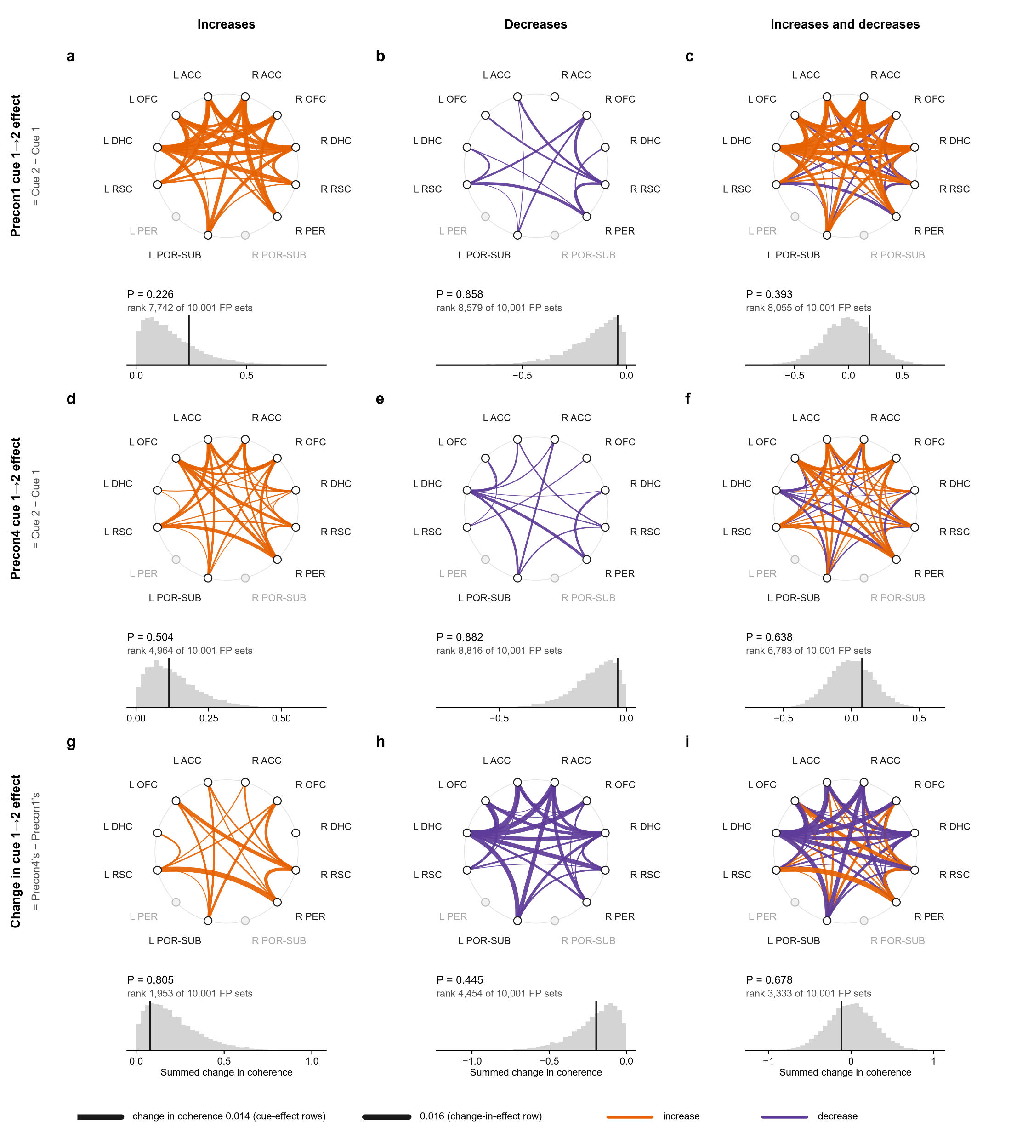
Here a row is the cue 1→2 effect: cue 2 − cue 1 on each day, every trial whatever its sounds; the bottom row its change.
The change in cue effect passes none of its 9 tests (smallest P = 0.16): no change from Precon1 to Precon4 here.
On Precon1 alone, the cue-1 effect’s increases pass FP (P = 0.007); the cue-1 effect’s ups and downs together pass FP (P = 0.018).
Figure 6
Comparison 5, cue 1 → cue 2, gamma: the whole network
On Precon4 alone, the cue-1 effect’s increases pass FP (P < 0.001) and shuffles (P = 0.007); the cue-1 effect’s ups and downs together pass FP (P < 0.001) and shuffles (P = 0.013).

Slide 50
Figure 6 · cue 1 → cue 2 · gamma
Here a row is the cue 1→2 effect: cue 2 − cue 1 on each day, every trial whatever its sounds; the bottom row its change.
The change in cue effect passes none of its 9 tests (smallest P = 0.19): no change from Precon1 to Precon4 here.
Notes:
Cue 1 → cue 2, gamma 30–90 Hz: the connectome of the change from Cue 1 to Cue 2. a–c, the Precon1 cue 1→2 effect (Cue 2 − Cue 1, on Precon1); d–f, the Precon4 cue 1→2 effect; g–i, the change in cue 1→2 effect (Precon4’s minus Precon1’s). Each ring holds the 12 regions (open, a region no pair reaches with at least 4 rats); each edge is one of the 44 pairs tested, curving toward the centre, its width the mean change in coherence from Cue 1 to Cue 2 over the rats (Dickson 2022: 59–61 Hz notch, hanning(1024), 512 overlap, 2,048 points, averaged over 30–90 Hz without 59–61 Hz), orange for an increase and purple for a decrease. Left column, the increases; middle, the decreases; right, both. Under each ring, its statistic (the summed increases, the summed decreases, or the sum of all) against 10,000 sets of fake trials from the same rats’ FP1 and FP2 recordings, where there were no cues: a fake cue onset every 10 s of FP, the trial’s own windows round it, measured as a trial’s are; in each set every session gets as many fake trials as it had real ones, drawn at random with replacement, each with its two windows in random order (with no cue, either can stand for it) and losing the windows the matching real trial lost to clipping, and its change is made as the real one is. The vertical line is the observed value, with its rank among the sets and its P (increases one-sided upward, decreases downward, both two-sided; *P < 0.05, **P < 0.01, ***P < 0.001; uncorrected). n = 8 rats, 12–16 trials per session. Significant: none.

Slide 51
Figure 6 · cue 1 → cue 2 · gamma
Here a row is the cue 1→2 effect: cue 2 − cue 1 on each day, every trial whatever its sounds; the bottom row its change.
The change in cue effect passes none of its 9 tests (smallest P = 0.19): no change from Precon1 to Precon4 here.
Notes:
Cue 1 → cue 2, gamma 30–90 Hz: the connectome of the change from Cue 1 to Cue 2. a–c, the Precon1 cue 1→2 effect (Cue 2 − Cue 1, on Precon1); d–f, the Precon4 cue 1→2 effect; g–i, the change in cue 1→2 effect (Precon4’s minus Precon1’s). Each ring holds the 12 regions (open, a region no pair reaches with at least 4 rats); each edge is one of the 44 pairs tested, curving toward the centre, its width the mean change in coherence from Cue 1 to Cue 2 over the rats (Dickson 2022: 59–61 Hz notch, hanning(1024), 512 overlap, 2,048 points, averaged over 30–90 Hz without 59–61 Hz), orange for an increase and purple for a decrease. Left column, the increases; middle, the decreases; right, both. Under each ring, its statistic (the summed increases, the summed decreases, or the sum of all) against 10,000 sets of fake trials from the same rats’ FP1 and FP2 recordings, where there were no cues: a fake cue onset every 10 s of FP, the trial’s own windows round it, measured as a trial’s are; in each set every session gets as many fake trials as it had real ones, drawn at random with replacement, each with its two windows in random order (with no cue, either can stand for it) and losing the windows the matching real trial lost to clipping, and its change is made as the real one is. The vertical line is the observed value, with its rank among the sets and its P (increases one-sided upward, decreases downward, both two-sided; *P < 0.05, **P < 0.01, ***P < 0.001; uncorrected). n = 8 rats, 12–16 trials per session. Significant: none.

Slide 52
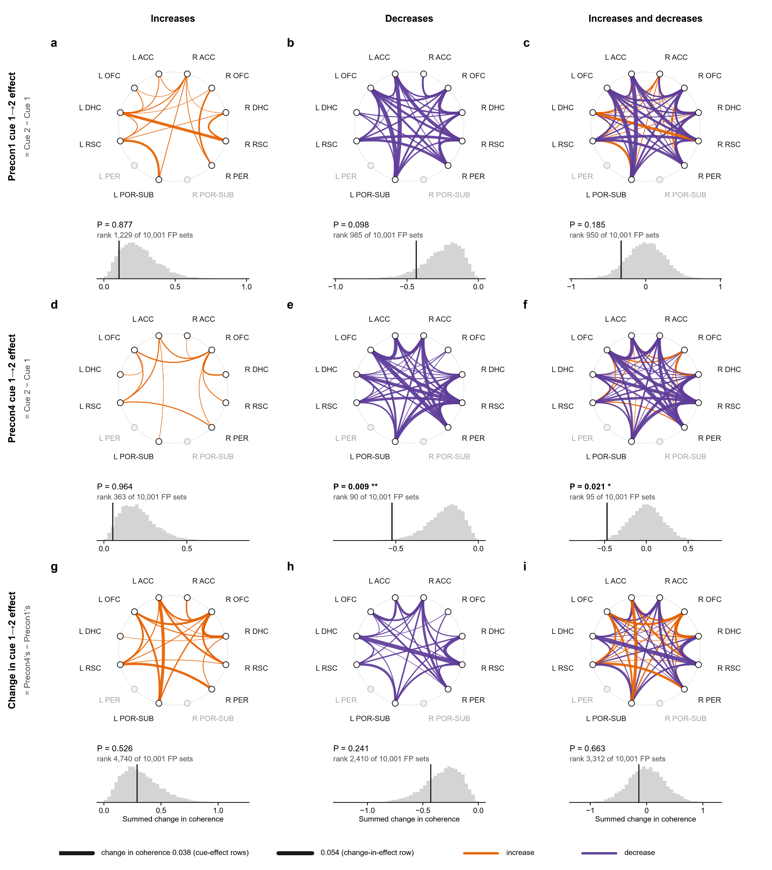
Here a row is the cue 1→2 effect: cue 2 − cue 1 on each day, every trial whatever its sounds; the bottom row its change.
Here a row is the cue 1→2 effect: cue 2 − cue 1 on each day, every trial whatever its sounds; the bottom row its change.
The change in cue effect passes none of its 9 tests (smallest P = 0.19): no change from Precon1 to Precon4 here.
Figure 5
Comparison 5, cue 1 → cue 2, theta: the whole network

Slide 53
Figure 5 · cue 1 → cue 2 · theta
Here a row is the cue 1→2 effect: cue 2 − cue 1 on each day, every trial whatever its sounds; the bottom row its change.
The change in cue effect passes none of its 9 tests (smallest P = 0.24): no change from Precon1 to Precon4 here.
Notes:
Cue 1 → cue 2, theta 5–12 Hz: the connectome of the change from Cue 1 to Cue 2. a–c, the Precon1 cue 1→2 effect (Cue 2 − Cue 1, on Precon1); d–f, the Precon4 cue 1→2 effect; g–i, the change in cue 1→2 effect (Precon4’s minus Precon1’s). Each ring holds the 12 regions (open, a region no pair reaches with at least 4 rats); each edge is one of the 44 pairs tested, curving toward the centre, its width the mean change in coherence from Cue 1 to Cue 2 over the rats (Dickson 2022: 59–61 Hz notch, hanning(1024), 512 overlap, 2,048 points, averaged over 30–90 Hz without 59–61 Hz), orange for an increase and purple for a decrease. Left column, the increases; middle, the decreases; right, both. Under each ring, its statistic (the summed increases, the summed decreases, or the sum of all) against 10,000 sets of fake trials from the same rats’ FP1 and FP2 recordings, where there were no cues: a fake cue onset every 10 s of FP, the trial’s own windows round it, measured as a trial’s are; in each set every session gets as many fake trials as it had real ones, drawn at random with replacement, each with its two windows in random order (with no cue, either can stand for it) and losing the windows the matching real trial lost to clipping, and its change is made as the real one is. The vertical line is the observed value, with its rank among the sets and its P (increases one-sided upward, decreases downward, both two-sided; *P < 0.05, **P < 0.01, ***P < 0.001; uncorrected). n = 8 rats, 12–16 trials per session. Significant: Precon4 cue 1→2 effect, decreases: P = 0.009; Precon4 cue 1→2 effect, both: P = 0.021.

Slide 54
Figure 5 · cue 1 → cue 2 · theta
Here a row is the cue 1→2 effect: cue 2 − cue 1 on each day, every trial whatever its sounds; the bottom row its change.
The change in cue effect passes none of its 9 tests (smallest P = 0.24): no change from Precon1 to Precon4 here.
On Precon4 alone, the cue 1→2 effect’s decreases pass FP (P = 0.009); the cue 1→2 effect’s ups and downs together pass FP (P = 0.021).
Notes:
Cue 1 → cue 2, theta 5–12 Hz: the connectome of the change from Cue 1 to Cue 2. a–c, the Precon1 cue 1→2 effect (Cue 2 − Cue 1, on Precon1); d–f, the Precon4 cue 1→2 effect; g–i, the change in cue 1→2 effect (Precon4’s minus Precon1’s). Each ring holds the 12 regions (open, a region no pair reaches with at least 4 rats); each edge is one of the 44 pairs tested, curving toward the centre, its width the mean change in coherence from Cue 1 to Cue 2 over the rats (Dickson 2022: 59–61 Hz notch, hanning(1024), 512 overlap, 2,048 points, averaged over 30–90 Hz without 59–61 Hz), orange for an increase and purple for a decrease. Left column, the increases; middle, the decreases; right, both. Under each ring, its statistic (the summed increases, the summed decreases, or the sum of all) against 10,000 sets of fake trials from the same rats’ FP1 and FP2 recordings, where there were no cues: a fake cue onset every 10 s of FP, the trial’s own windows round it, measured as a trial’s are; in each set every session gets as many fake trials as it had real ones, drawn at random with replacement, each with its two windows in random order (with no cue, either can stand for it) and losing the windows the matching real trial lost to clipping, and its change is made as the real one is. The vertical line is the observed value, with its rank among the sets and its P (increases one-sided upward, decreases downward, both two-sided; *P < 0.05, **P < 0.01, ***P < 0.001; uncorrected). n = 8 rats, 12–16 trials per session. Significant: Precon4 cue 1→2 effect, decreases: P = 0.009; Precon4 cue 1→2 effect, both: P = 0.021.

Slide 55
Figure 5 · cue 1 → cue 2 · theta
Here a row is the cue 1→2 effect: cue 2 − cue 1 on each day, every trial whatever its sounds; the bottom row its change.
Where a light lit (comparisons 1 and 2, gamma), tab 8 looked closer at single pairs, with four kinds of extra test.
The change in cue effect passes none of its 9 tests (smallest P = 0.24): no change from Precon1 to Precon4 here.
On Precon4 alone, the cue 1→2 effect’s decreases pass FP (P = 0.009); the cue 1→2 effect’s ups and downs together pass FP (P = 0.021).
Notes:
One day's cue effect, not the change across days: on that day the cue moved theta coherence beyond what FP or the shuffles give.

Slide 56
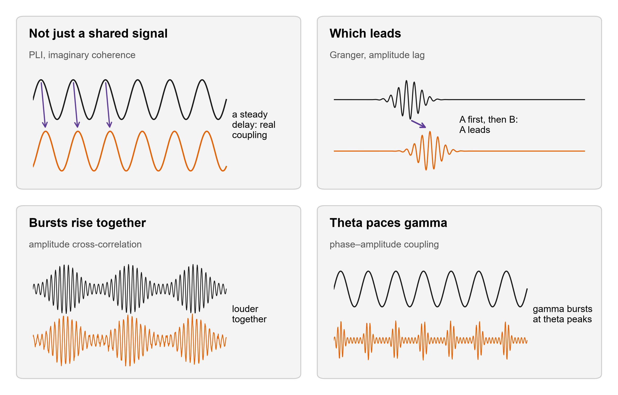
The follow-ups
Where a light lit (comparisons 1 and 2, gamma), tab 8 looked closer at single pairs, with four kinds of extra test.
Here a row is the cue 1→2 effect: cue 2 − cue 1 on each day, every trial whatever its sounds; the bottom row its change.
Not just a shared signal: two wires can look coherent because they pick up the same source. PLI and imaginary coherence count only coupling with a delay: PLI asks how steadily one rhythm runs ahead, imaginary coherence also weighs how strongly.
The change in cue effect passes none of its 9 tests (smallest P = 0.24): no change from Precon1 to Precon4 here.
On Precon4 alone, the cue 1→2 effect’s decreases pass FP (P = 0.009); the cue 1→2 effect’s ups and downs together pass FP (P = 0.021).

Slide 57
The follow-ups
Where a light lit (comparisons 1 and 2, gamma), tab 8 looked closer at single pairs, with four kinds of extra test.
Which leads: Granger asks if one region’s past predicts the other’s future; the lag asks whose gamma bursts come first.
Not just a shared signal: two wires can look coherent because they pick up the same source. PLI and imaginary coherence count only coupling with a delay: PLI asks how steadily one rhythm runs ahead, imaginary coherence also weighs how strongly.

Slide 58
The follow-ups
Which leads: Granger asks if one region’s past predicts the other’s future; the lag asks whose gamma bursts come first.
Where a light lit (comparisons 1 and 2, gamma), tab 8 looked closer at single pairs, with four kinds of extra test.
Not just a shared signal: two wires can look coherent because they pick up the same source. PLI and imaginary coherence count only coupling with a delay: PLI asks how steadily one rhythm runs ahead, imaginary coherence also weighs how strongly.
Bursts rise together: do the two regions’ gamma get loud at the same moments?

Slide 59
The follow-ups
Which leads: Granger asks if one region’s past predicts the other’s future; the lag asks whose gamma bursts come first.
Theta paces gamma: do gamma bursts in one region ride the theta cycle of another (or its own)? Measured as a modulation index over each trial’s whole window, then the mean of the trials.
Bursts rise together: do the two regions’ gamma get loud at the same moments?

Slide 60
The follow-ups
Theta paces gamma: do gamma bursts in one region ride the theta cycle of another (or its own)? Measured as a modulation index over each trial’s whole window, then the mean of the trials.
How to read a follow-up figure. a: the pair, on the same ring (an arrow when a direction was measured).
Which leads: Granger asks if one region’s past predicts the other’s future; the lag asks whose gamma bursts come first.
Bursts rise together: do the two regions’ gamma get loud at the same moments?

Slide 61
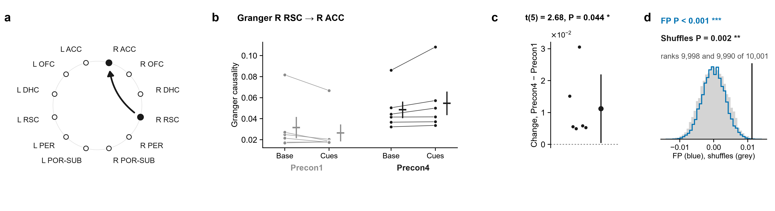
2.1 · R ACC – R RSC · Which leads
How to read a follow-up figure. a: the pair, on the same ring (an arrow when a direction was measured).
Theta paces gamma: do gamma bursts in one region ride the theta cycle of another (or its own)? Measured as a modulation index over each trial’s whole window, then the mean of the trials.
b: each rat’s baseline and cue, Precon1 in grey and Precon4 in black.
Notes:
Baseline (20 s) → both cues · followed up from the gamma coherence of R ACC – R RSC: direction. a, the pair on the ring of regions (the arrow, the direction measured). Then, for each measure: its value for each rat at Baseline (20 s) and Cue 1 + Cue 2 (20 s) on Precon1 (grey) and Precon4 (black), each rat's two windows joined, the mean ± s.e.m. beside them; each rat's change between the days, (Precon4 Cue 1 + Cue 2 (20 s) − Baseline (20 s)) − (Precon1 Cue 1 + Cue 2 (20 s) − Baseline (20 s)), with the mean ± 95% confidence interval; and that mean against 10,000 shuffles in which each session's trials had their two windows swapped at random (grey) and against 10,000 sets of fake trials from the same rats' FP1 and FP2, where there were no cues, each session as many as it had real trials, in random order, losing the windows its real trials lost (blue). The pair was followed up because its own change in coherence had P < 0.05 (uncorrected; no pair survives correction on its own), and of the measures run on it these are the ones whose t-test had P < 0.05: they are leads, chosen by that test. Granger R RSC → R ACC: FP intervals P < 0.001, rank 9,998 of 10,001; within-session shuffles P = 0.002, rank 9,990 of 10,001; t(5) = 2.68, P = 0.044 (one-sample t-test of each rat's change, uncorrected).

Slide 62
2.1 · R ACC – R RSC · Which leads
How to read a follow-up figure. a: the pair, on the same ring (an arrow when a direction was measured).
b: each rat’s baseline and cue, Precon1 in grey and Precon4 in black.
c: each rat’s change in cue effect, Precon4’s − Precon1’s, with the mean and its 95% range. The t-test asks if the mean is away from 0.

Slide 63
2.1 · R ACC – R RSC · Which leads
How to read a follow-up figure. a: the pair, on the same ring (an arrow when a direction was measured).
b: each rat’s baseline and cue, Precon1 in grey and Precon4 in black.
c: each rat’s change in cue effect, Precon4’s − Precon1’s, with the mean and its 95% range. The t-test asks if the mean is away from 0.
d: the same change against FP (blue, 10,000 sets of fake trials) and the shuffles (grey, 10,000 within-session swaps).

Slide 64
2.1 · R ACC – R RSC · Which leads
How to read a follow-up figure. a: the pair, on the same ring (an arrow when a direction was measured).
Tab 8 ran 190 of these t-tests (19 pairs × 10 measures); 21 passed, where about 10 would by chance. Those 21 are the measures in these 20 figures, sorted by how many of FP, shuffles and t-test they pass.
b: each rat’s baseline and cue, Precon1 in grey and Precon4 in black.
c: each rat’s change in cue effect, Precon4’s − Precon1’s, with the mean and its 95% range. The t-test asks if the mean is away from 0.
d: the same change against FP (blue, 10,000 sets of fake trials) and the shuffles (grey, 10,000 within-session swaps).

Slide 65
2.1 · R ACC – R RSC · Which leads
Tab 8 ran 190 of these t-tests (19 pairs × 10 measures); 21 passed, where about 10 would by chance. Those 21 are the measures in these 20 figures, sorted by how many of FP, shuffles and t-test they pass.
R RSC predicting R ACC (Granger R RSC → R ACC): cue − baseline was higher on Precon4 than on Precon1.
How to read a follow-up figure. a: the pair, on the same ring (an arrow when a direction was measured).
b: each rat’s baseline and cue, Precon1 in grey and Precon4 in black.
c: each rat’s change in cue effect, Precon4’s − Precon1’s, with the mean and its 95% range. The t-test asks if the mean is away from 0.
d: the same change against FP (blue, 10,000 sets of fake trials) and the shuffles (grey, 10,000 within-session swaps).

Slide 66
2.1 · R ACC – R RSC · Which leads
R RSC predicting R ACC (Granger R RSC → R ACC): cue − baseline was higher on Precon4 than on Precon1.
Tab 8 ran 190 of these t-tests (19 pairs × 10 measures); 21 passed, where about 10 would by chance. Those 21 are the measures in these 20 figures, sorted by how many of FP, shuffles and t-test they pass.
FP P < 0.001. Shuffles P = 0.002. t-test P = 0.044 (6 rats). All three tests agree: the strongest lead.
Notes:
Baseline (20 s) → both cues · followed up from the gamma coherence of R ACC – R RSC: direction. a, the pair on the ring of regions (the arrow, the direction measured). Then, for each measure: its value for each rat at Baseline (20 s) and Cue 1 + Cue 2 (20 s) on Precon1 (grey) and Precon4 (black), each rat's two windows joined, the mean ± s.e.m. beside them; each rat's change between the days, (Precon4 Cue 1 + Cue 2 (20 s) − Baseline (20 s)) − (Precon1 Cue 1 + Cue 2 (20 s) − Baseline (20 s)), with the mean ± 95% confidence interval; and that mean against 10,000 shuffles in which each session's trials had their two windows swapped at random (grey) and against 10,000 sets of fake trials from the same rats' FP1 and FP2, where there were no cues, each session as many as it had real trials, in random order, losing the windows its real trials lost (blue). The pair was followed up because its own change in coherence had P < 0.05 (uncorrected; no pair survives correction on its own), and of the measures run on it these are the ones whose t-test had P < 0.05: they are leads, chosen by that test. Granger R RSC → R ACC: FP intervals P < 0.001, rank 9,998 of 10,001; within-session shuffles P = 0.002, rank 9,990 of 10,001; t(5) = 2.68, P = 0.044 (one-sample t-test of each rat's change, uncorrected).

Slide 67
2.1 · R ACC – R RSC · Which leads
R RSC predicting R ACC (Granger R RSC → R ACC): cue − baseline was higher on Precon4 than on Precon1.
Theta in R RSC pacing gamma in R ACC (PAC): cue − baseline was lower on Precon4 than on Precon1.
FP P < 0.001. Shuffles P = 0.002. t-test P = 0.044 (6 rats). All three tests agree: the strongest lead.
Notes:
FP: rank 9998 of 10001, P < 0.001. Shuffles: rank 9990 of 10001, P = 0.002. t(5) = 2.68, P = 0.044; mean change 0.01122.

Slide 68
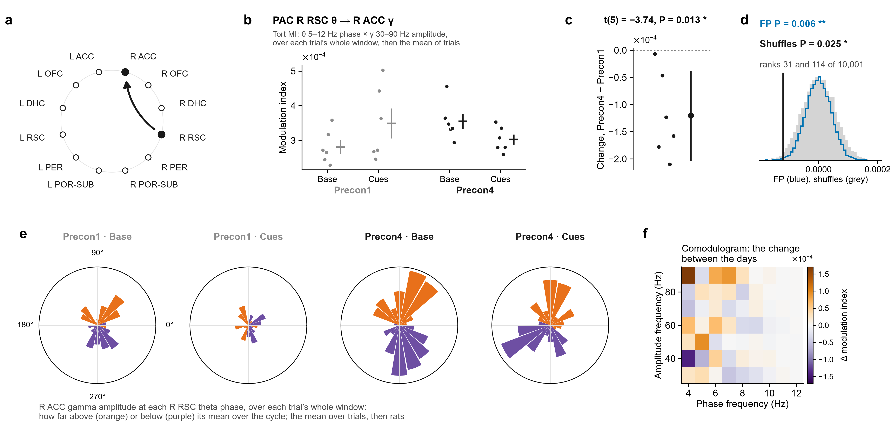
2.2 · R ACC – R RSC · Theta paces gamma
Theta in R RSC pacing gamma in R ACC (PAC): cue − baseline was lower on Precon4 than on Precon1.
R RSC predicting R ACC (Granger R RSC → R ACC): cue − baseline was higher on Precon4 than on Precon1.
FP P = 0.006. Shuffles P = 0.025. t-test P = 0.013 (6 rats). All three tests agree: the strongest lead.
FP P < 0.001. Shuffles P = 0.002. t-test P = 0.044 (6 rats). All three tests agree: the strongest lead.
Notes:
Baseline (20 s) → both cues · followed up from the gamma coherence of R ACC – R RSC: theta–gamma coupling, R RSC θ → R ACC γ. a, the pair on the ring of regions (the arrow, the direction measured). Then, for each measure: its value for each rat at Baseline (20 s) and Cue 1 + Cue 2 (20 s) on Precon1 (grey) and Precon4 (black), each rat's values as dots (PAC is never drawn as lines), the mean ± s.e.m. beside them; each rat's change between the days, (Precon4 Cue 1 + Cue 2 (20 s) − Baseline (20 s)) − (Precon1 Cue 1 + Cue 2 (20 s) − Baseline (20 s)), with the mean ± 95% confidence interval; and that mean against 10,000 shuffles in which each session's trials had their two windows swapped at random (grey) and against 10,000 sets of fake trials from the same rats' FP1 and FP2, where there were no cues, each session as many as it had real trials, in random order, losing the windows its real trials lost (blue). The pair was followed up because its own change in coherence had P < 0.05 (uncorrected; no pair survives correction on its own), and of the measures run on it these are the ones whose t-test had P < 0.05: they are leads, chosen by that test. PAC is Tort's modulation index (18 theta-phase bins) of gamma (30–90 Hz) amplitude over theta (5–12 Hz) phase, computed over each trial's whole window (the whole baseline, or the whole cue window), then averaged over the session's trials: a dot is one rat. The roses are the same windows' gamma amplitude in each theta-phase bin, normalised, averaged over the trials and then the rats; the comodulogram is the change in cue effect in narrow theta (2 Hz) and gamma (10 Hz) bands. PAC R RSC θ → R ACC γ: FP intervals P = 0.006, rank 31 of 10,001; within-session shuffles P = 0.025, rank 114 of 10,001; t(5) = −3.74, P = 0.013 (one-sample t-test of each rat's change, uncorrected).

Slide 69
2.2 · R ACC – R RSC · Theta paces gamma
Theta in R RSC pacing gamma in R ACC (PAC): cue − baseline was lower on Precon4 than on Precon1.
The roses: R ACC gamma around the R RSC theta cycle, over each trial’s whole window, averaged over trials and then rats. Orange: louder at that phase than its average over the cycle; purple: quieter.
FP P = 0.006. Shuffles P = 0.025. t-test P = 0.013 (6 rats). All three tests agree: the strongest lead.
Notes:
FP: rank 31 of 10001, P = 0.006. Shuffles: rank 114 of 10001, P = 0.025. t(5) = -3.74, P = 0.013; mean change -0.0001204.

Slide 70
2.2 · R ACC – R RSC · Theta paces gamma
The roses: R ACC gamma around the R RSC theta cycle, over each trial’s whole window, averaged over trials and then rats. Orange: louder at that phase than its average over the cycle; purple: quieter.
Theta in R RSC pacing gamma in R ACC (PAC): cue − baseline was lower on Precon4 than on Precon1.
FP P = 0.006. Shuffles P = 0.025. t-test P = 0.013 (6 rats). All three tests agree: the strongest lead.
Precon1 on the left, Precon4 on the right; baseline, then the cue. Rats that prefer different phases cancel, so a rose shows where in the cycle, not how much: b and c are what was tested.
Notes:
Mean over rats of each rat's normalised gamma amplitude in 18 theta-phase bins, read from the recordings (the VACC's copies) through tab 8's own wires; the four roses share one scale.

Slide 71
2.2 · R ACC – R RSC · Theta paces gamma
The roses: R ACC gamma around the R RSC theta cycle, over each trial’s whole window, averaged over trials and then rats. Orange: louder at that phase than its average over the cycle; purple: quieter.
Precon1 on the left, Precon4 on the right; baseline, then the cue. Rats that prefer different phases cancel, so a rose shows where in the cycle, not how much: b and c are what was tested.
The comodulogram: the same change in cue effect split into narrow theta bands (across) and gamma bands (up). Orange: the cue raised coupling more on Precon4; purple: less. A map, not the test: c is the result.

Slide 72
2.2 · R ACC – R RSC · Theta paces gamma
The roses: R ACC gamma around the R RSC theta cycle, over each trial’s whole window, averaged over trials and then rats. Orange: louder at that phase than its average over the cycle; purple: quieter.
R DHC and L RSC gamma bursts rising together (amplitude correlation): cue − baseline was higher on Precon4 than on Precon1.
Precon1 on the left, Precon4 on the right; baseline, then the cue. Rats that prefer different phases cancel, so a rose shows where in the cycle, not how much: b and c are what was tested.
The comodulogram: the same change in cue effect split into narrow theta bands (across) and gamma bands (up). Orange: the cue raised coupling more on Precon4; purple: less. A map, not the test: c is the result.

Slide 73
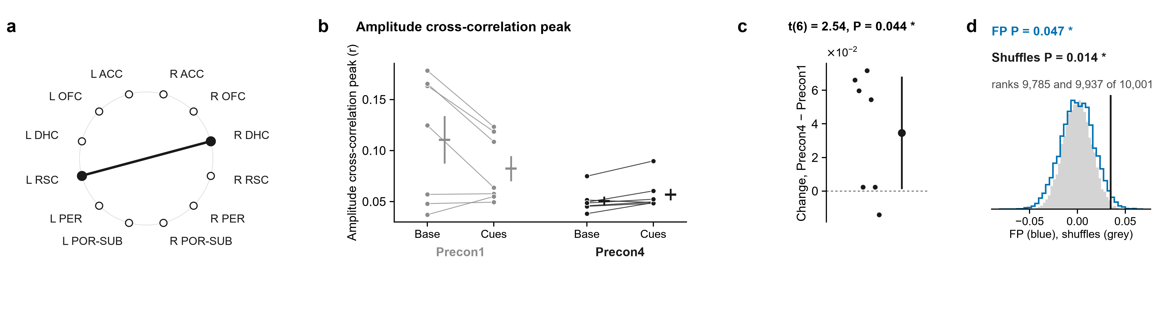
2.3 · R DHC – L RSC · Bursts rise together
R DHC and L RSC gamma bursts rising together (amplitude correlation): cue − baseline was higher on Precon4 than on Precon1.
The roses: R ACC gamma around the R RSC theta cycle, over each trial’s whole window, averaged over trials and then rats. Orange: louder at that phase than its average over the cycle; purple: quieter.
FP P = 0.047. Shuffles P = 0.014. t-test P = 0.044 (7 rats). All three tests agree: the strongest lead.
Precon1 on the left, Precon4 on the right; baseline, then the cue. Rats that prefer different phases cancel, so a rose shows where in the cycle, not how much: b and c are what was tested.
The comodulogram: the same change in cue effect split into narrow theta bands (across) and gamma bands (up). Orange: the cue raised coupling more on Precon4; purple: less. A map, not the test: c is the result.
Notes:
Baseline (20 s) → both cues · followed up from the gamma coherence of R DHC – L RSC: amplitudes together. a, the pair on the ring of regions. Then, for each measure: its value for each rat at Baseline (20 s) and Cue 1 + Cue 2 (20 s) on Precon1 (grey) and Precon4 (black), each rat's two windows joined, the mean ± s.e.m. beside them; each rat's change between the days, (Precon4 Cue 1 + Cue 2 (20 s) − Baseline (20 s)) − (Precon1 Cue 1 + Cue 2 (20 s) − Baseline (20 s)), with the mean ± 95% confidence interval; and that mean against 10,000 shuffles in which each session's trials had their two windows swapped at random (grey) and against 10,000 sets of fake trials from the same rats' FP1 and FP2, where there were no cues, each session as many as it had real trials, in random order, losing the windows its real trials lost (blue). The pair was followed up because its own change in coherence had P < 0.05 (uncorrected; no pair survives correction on its own), and of the measures run on it these are the ones whose t-test had P < 0.05: they are leads, chosen by that test. Amplitude cross-correlation peak: FP intervals P = 0.047, rank 9,785 of 10,001; within-session shuffles P = 0.014, rank 9,937 of 10,001; t(6) = 2.54, P = 0.044 (one-sample t-test of each rat's change, uncorrected).

Slide 74
2.3 · R DHC – L RSC · Bursts rise together
R DHC and L RSC gamma bursts rising together (amplitude correlation): cue − baseline was higher on Precon4 than on Precon1.
R RSC predicting L POR-SUB (Granger R RSC → L POR-SUB): cue − baseline was higher on Precon4 than on Precon1.
FP P = 0.047. Shuffles P = 0.014. t-test P = 0.044 (7 rats). All three tests agree: the strongest lead.
Notes:
FP: rank 9785 of 10001, P = 0.047. Shuffles: rank 9937 of 10001, P = 0.014. t(6) = 2.54, P = 0.044; mean change 0.03468.

Slide 75
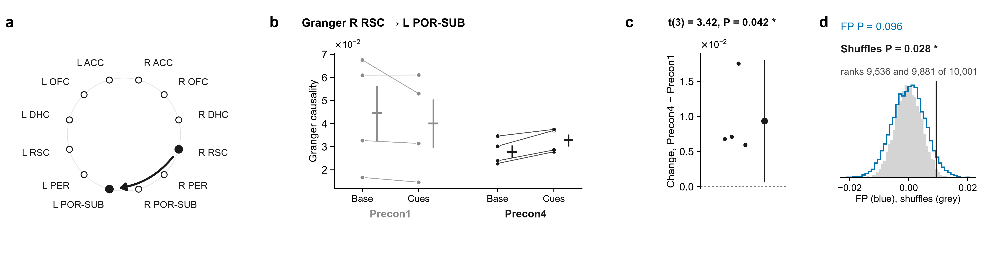
2.4 · R RSC – L POR-SUB · Which leads
R RSC predicting L POR-SUB (Granger R RSC → L POR-SUB): cue − baseline was higher on Precon4 than on Precon1.
R DHC and L RSC gamma bursts rising together (amplitude correlation): cue − baseline was higher on Precon4 than on Precon1.
FP P = 0.096. Shuffles P = 0.028. t-test P = 0.042 (4 rats). Two of the three agree: a middling lead.
FP P = 0.047. Shuffles P = 0.014. t-test P = 0.044 (7 rats). All three tests agree: the strongest lead.
Notes:
Baseline (20 s) → both cues · followed up from the gamma coherence of R RSC – L POR-SUB: direction. a, the pair on the ring of regions (the arrow, the direction measured). Then, for each measure: its value for each rat at Baseline (20 s) and Cue 1 + Cue 2 (20 s) on Precon1 (grey) and Precon4 (black), each rat's two windows joined, the mean ± s.e.m. beside them; each rat's change between the days, (Precon4 Cue 1 + Cue 2 (20 s) − Baseline (20 s)) − (Precon1 Cue 1 + Cue 2 (20 s) − Baseline (20 s)), with the mean ± 95% confidence interval; and that mean against 10,000 shuffles in which each session's trials had their two windows swapped at random (grey) and against 10,000 sets of fake trials from the same rats' FP1 and FP2, where there were no cues, each session as many as it had real trials, in random order, losing the windows its real trials lost (blue). The pair was followed up because its own change in coherence had P < 0.05 (uncorrected; no pair survives correction on its own), and of the measures run on it these are the ones whose t-test had P < 0.05: they are leads, chosen by that test. Granger R RSC → L POR-SUB: FP intervals P = 0.096, rank 9,536 of 10,001; within-session shuffles P = 0.028, rank 9,881 of 10,001; t(3) = 3.42, P = 0.042 (one-sample t-test of each rat's change, uncorrected).

Slide 76
2.4 · R RSC – L POR-SUB · Which leads
R RSC predicting L POR-SUB (Granger R RSC → L POR-SUB): cue − baseline was higher on Precon4 than on Precon1.
Coupling with a real delay, R ACC with R RSC (imaginary coherence): cue − baseline was higher on Precon4 than on Precon1.
FP P = 0.096. Shuffles P = 0.028. t-test P = 0.042 (4 rats). Two of the three agree: a middling lead.
Notes:
FP: rank 9536 of 10001, P = 0.096. Shuffles: rank 9881 of 10001, P = 0.028. t(3) = 3.42, P = 0.042; mean change 0.009354.

Slide 77
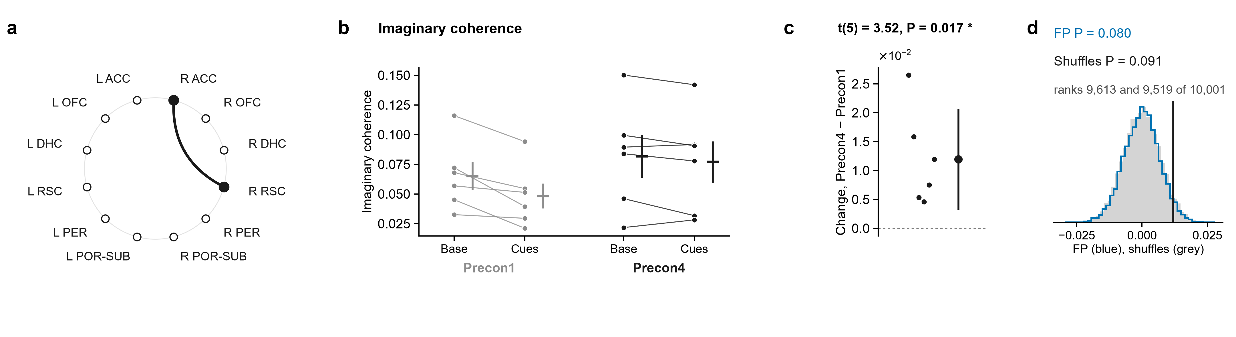
2.5 · R ACC – R RSC · Not just a shared signal
Coupling with a real delay, R ACC with R RSC (imaginary coherence): cue − baseline was higher on Precon4 than on Precon1.
R RSC predicting L POR-SUB (Granger R RSC → L POR-SUB): cue − baseline was higher on Precon4 than on Precon1.
FP P = 0.080. Shuffles P = 0.091. t-test P = 0.017 (6 rats). One test only: a weaker lead.
FP P = 0.096. Shuffles P = 0.028. t-test P = 0.042 (4 rats). Two of the three agree: a middling lead.
Notes:
Baseline (20 s) → both cues · followed up from the gamma coherence of R ACC – R RSC: not volume conduction. a, the pair on the ring of regions. Then, for each measure: its value for each rat at Baseline (20 s) and Cue 1 + Cue 2 (20 s) on Precon1 (grey) and Precon4 (black), each rat's two windows joined, the mean ± s.e.m. beside them; each rat's change between the days, (Precon4 Cue 1 + Cue 2 (20 s) − Baseline (20 s)) − (Precon1 Cue 1 + Cue 2 (20 s) − Baseline (20 s)), with the mean ± 95% confidence interval; and that mean against 10,000 shuffles in which each session's trials had their two windows swapped at random (grey) and against 10,000 sets of fake trials from the same rats' FP1 and FP2, where there were no cues, each session as many as it had real trials, in random order, losing the windows its real trials lost (blue). The pair was followed up because its own change in coherence had P < 0.05 (uncorrected; no pair survives correction on its own), and of the measures run on it these are the ones whose t-test had P < 0.05: they are leads, chosen by that test. Imaginary coherence: FP intervals P = 0.080, rank 9,613 of 10,001; within-session shuffles P = 0.091, rank 9,519 of 10,001; t(5) = 3.52, P = 0.017 (one-sample t-test of each rat's change, uncorrected).

Slide 78
2.5 · R ACC – R RSC · Not just a shared signal
Coupling with a real delay, R ACC with R RSC (imaginary coherence): cue − baseline was higher on Precon4 than on Precon1.
R PER and L DHC gamma bursts rising together (amplitude correlation): cue − baseline was lower on Precon4 than on Precon1.
FP P = 0.080. Shuffles P = 0.091. t-test P = 0.017 (6 rats). One test only: a weaker lead.
Notes:
FP: rank 9613 of 10001, P = 0.080. Shuffles: rank 9519 of 10001, P = 0.091. t(5) = 3.52, P = 0.017; mean change 0.01195.

Slide 79
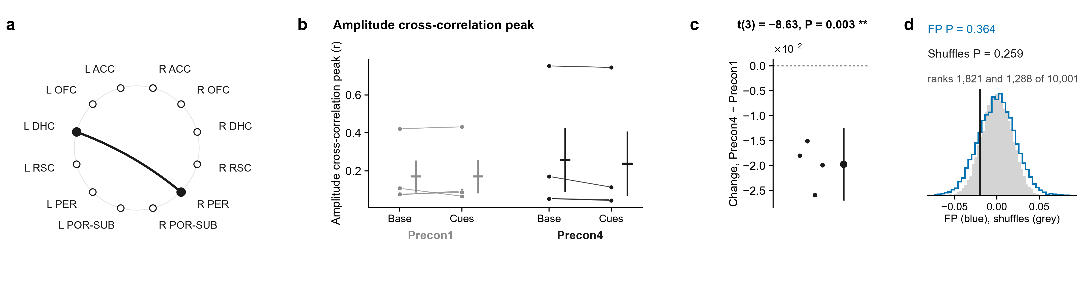
2.6 · R PER – L DHC · Bursts rise together
R PER and L DHC gamma bursts rising together (amplitude correlation): cue − baseline was lower on Precon4 than on Precon1.
Coupling with a real delay, R ACC with R RSC (imaginary coherence): cue − baseline was higher on Precon4 than on Precon1.
FP P = 0.364. Shuffles P = 0.259. t-test P = 0.003 (4 rats). One test only: a weaker lead.
FP P = 0.080. Shuffles P = 0.091. t-test P = 0.017 (6 rats). One test only: a weaker lead.
Notes:
Baseline (20 s) → both cues · followed up from the gamma coherence of R PER – L DHC: amplitudes together. a, the pair on the ring of regions. Then, for each measure: its value for each rat at Baseline (20 s) and Cue 1 + Cue 2 (20 s) on Precon1 (grey) and Precon4 (black), each rat's two windows joined, the mean ± s.e.m. beside them; each rat's change between the days, (Precon4 Cue 1 + Cue 2 (20 s) − Baseline (20 s)) − (Precon1 Cue 1 + Cue 2 (20 s) − Baseline (20 s)), with the mean ± 95% confidence interval; and that mean against 10,000 shuffles in which each session's trials had their two windows swapped at random (grey) and against 10,000 sets of fake trials from the same rats' FP1 and FP2, where there were no cues, each session as many as it had real trials, in random order, losing the windows its real trials lost (blue). The pair was followed up because its own change in coherence had P < 0.05 (uncorrected; no pair survives correction on its own), and of the measures run on it these are the ones whose t-test had P < 0.05: they are leads, chosen by that test. Amplitude cross-correlation peak: FP intervals P = 0.364, rank 1,821 of 10,001; within-session shuffles P = 0.259, rank 1,288 of 10,001; t(3) = −8.63, P = 0.003 (one-sample t-test of each rat's change, uncorrected).

Slide 80
2.6 · R PER – L DHC · Bursts rise together
R PER and L DHC gamma bursts rising together (amplitude correlation): cue − baseline was lower on Precon4 than on Precon1.
Theta pacing gamma within R PER (PAC): cue − baseline was higher on Precon4 than on Precon1.
FP P = 0.364. Shuffles P = 0.259. t-test P = 0.003 (4 rats). One test only: a weaker lead.
Notes:
FP: rank 1821 of 10001, P = 0.364. Shuffles: rank 1288 of 10001, P = 0.259. t(3) = -8.63, P = 0.003; mean change -0.01971.

Slide 81
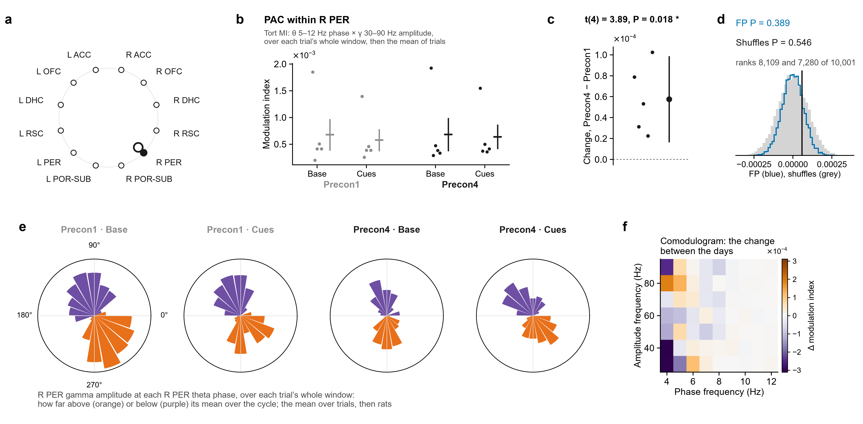
2.7 · R PER – L DHC · Theta paces gamma
Theta pacing gamma within R PER (PAC): cue − baseline was higher on Precon4 than on Precon1.
R PER and L DHC gamma bursts rising together (amplitude correlation): cue − baseline was lower on Precon4 than on Precon1.
FP P = 0.389. Shuffles P = 0.546. t-test P = 0.018 (5 rats). One test only: a weaker lead.
FP P = 0.364. Shuffles P = 0.259. t-test P = 0.003 (4 rats). One test only: a weaker lead.
Notes:
Baseline (20 s) → both cues · followed up from the gamma coherence of R PER – L DHC: theta–gamma coupling within R PER. a, the pair on the ring of regions. Then, for each measure: its value for each rat at Baseline (20 s) and Cue 1 + Cue 2 (20 s) on Precon1 (grey) and Precon4 (black), each rat's values as dots (PAC is never drawn as lines), the mean ± s.e.m. beside them; each rat's change between the days, (Precon4 Cue 1 + Cue 2 (20 s) − Baseline (20 s)) − (Precon1 Cue 1 + Cue 2 (20 s) − Baseline (20 s)), with the mean ± 95% confidence interval; and that mean against 10,000 shuffles in which each session's trials had their two windows swapped at random (grey) and against 10,000 sets of fake trials from the same rats' FP1 and FP2, where there were no cues, each session as many as it had real trials, in random order, losing the windows its real trials lost (blue). The pair was followed up because its own change in coherence had P < 0.05 (uncorrected; no pair survives correction on its own), and of the measures run on it these are the ones whose t-test had P < 0.05: they are leads, chosen by that test. PAC is Tort's modulation index (18 theta-phase bins) of gamma (30–90 Hz) amplitude over theta (5–12 Hz) phase, computed over each trial's whole window (the whole baseline, or the whole cue window), then averaged over the session's trials: a dot is one rat. The roses are the same windows' gamma amplitude in each theta-phase bin, normalised, averaged over the trials and then the rats; the comodulogram is the change in cue effect in narrow theta (2 Hz) and gamma (10 Hz) bands. PAC within R PER: FP intervals P = 0.389, rank 8,109 of 10,001; within-session shuffles P = 0.546, rank 7,280 of 10,001; t(4) = 3.89, P = 0.018 (one-sample t-test of each rat's change, uncorrected).

Slide 82
2.7 · R PER – L DHC · Theta paces gamma
Theta pacing gamma within R PER (PAC): cue − baseline was higher on Precon4 than on Precon1.
Its roses: R PER gamma around the R PER theta cycle, averaged over trials and rats, Precon1 then Precon4. Where in the cycle, not how much: c is the result.
FP P = 0.389. Shuffles P = 0.546. t-test P = 0.018 (5 rats). One test only: a weaker lead.
Notes:
FP: rank 8109 of 10001, P = 0.389. Shuffles: rank 7280 of 10001, P = 0.546. t(4) = 3.89, P = 0.018; mean change 5.763e-05.

Slide 83
2.7 · R PER – L DHC · Theta paces gamma
Its roses: R PER gamma around the R PER theta cycle, averaged over trials and rats, Precon1 then Precon4. Where in the cycle, not how much: c is the result.
Steady-delay coupling, R ACC with L OFC (PLI): cue − baseline was higher on Precon4 than on Precon1.
Theta pacing gamma within R PER (PAC): cue − baseline was higher on Precon4 than on Precon1.
FP P = 0.389. Shuffles P = 0.546. t-test P = 0.018 (5 rats). One test only: a weaker lead.

Slide 84
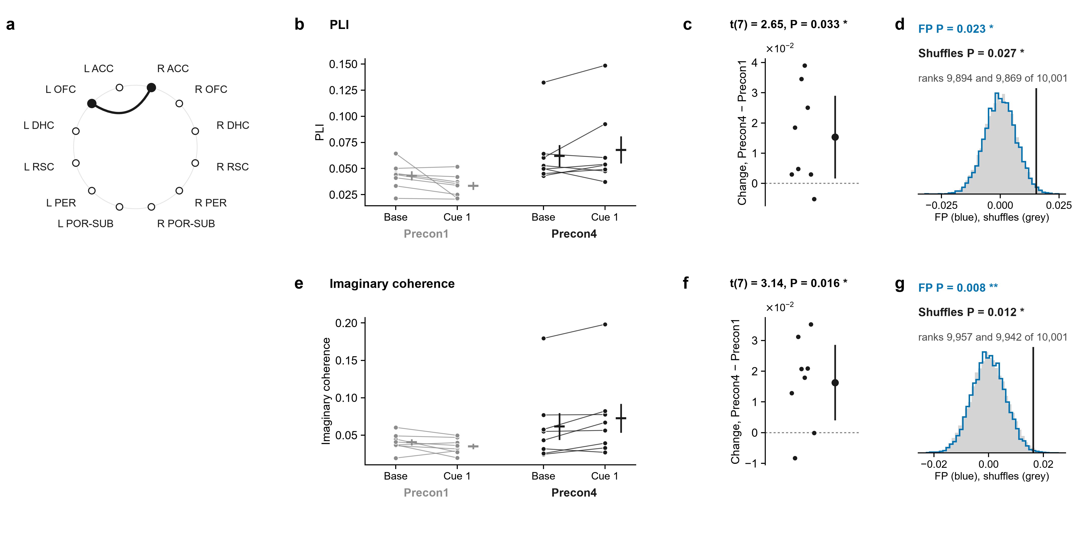
4.1 · R ACC – L OFC · Not just a shared signal
Steady-delay coupling, R ACC with L OFC (PLI): cue − baseline was higher on Precon4 than on Precon1.
Its roses: R PER gamma around the R PER theta cycle, averaged over trials and rats, Precon1 then Precon4. Where in the cycle, not how much: c is the result.
FP P = 0.023. Shuffles P = 0.027. t-test P = 0.033 (8 rats). All three tests agree: the strongest lead.
Notes:
Baseline (10 s) → cue 1 · followed up from the gamma coherence of R ACC – L OFC: not volume conduction. a, the pair on the ring of regions. Then, for each measure: its value for each rat at Baseline (10 s) and Cue 1 on Precon1 (grey) and Precon4 (black), each rat's two windows joined, the mean ± s.e.m. beside them; each rat's change between the days, (Precon4 Cue 1 − Baseline (10 s)) − (Precon1 Cue 1 − Baseline (10 s)), with the mean ± 95% confidence interval; and that mean against 10,000 shuffles in which each session's trials had their two windows swapped at random (grey) and against 10,000 sets of fake trials from the same rats' FP1 and FP2, where there were no cues, each session as many as it had real trials, in random order, losing the windows its real trials lost (blue). The pair was followed up because its own change in coherence had P < 0.05 (uncorrected; no pair survives correction on its own), and of the measures run on it these are the ones whose t-test had P < 0.05: they are leads, chosen by that test. PLI: FP intervals P = 0.023, rank 9,894 of 10,001; within-session shuffles P = 0.027, rank 9,869 of 10,001; t(7) = 2.65, P = 0.033 (one-sample t-test of each rat's change, uncorrected); Imaginary coherence: FP intervals P = 0.008, rank 9,957 of 10,001; within-session shuffles P = 0.012, rank 9,942 of 10,001; t(7) = 3.14, P = 0.016 (one-sample t-test of each rat's change, uncorrected).

Slide 85
4.1 · R ACC – L OFC · Not just a shared signal
Steady-delay coupling, R ACC with L OFC (PLI): cue − baseline was higher on Precon4 than on Precon1.
FP P = 0.023. Shuffles P = 0.027. t-test P = 0.033 (8 rats). All three tests agree: the strongest lead.
Coupling with a real delay, R ACC with L OFC (imaginary coherence): cue − baseline was higher on Precon4 than on Precon1.
Notes:
FP: rank 9894 of 10001, P = 0.023. Shuffles: rank 9869 of 10001, P = 0.027. t(7) = 2.65, P = 0.033; mean change 0.01533.

Slide 86
4.1 · R ACC – L OFC · Not just a shared signal
Steady-delay coupling, R ACC with L OFC (PLI): cue − baseline was higher on Precon4 than on Precon1.
FP P = 0.023. Shuffles P = 0.027. t-test P = 0.033 (8 rats). All three tests agree: the strongest lead.
Coupling with a real delay, R ACC with L OFC (imaginary coherence): cue − baseline was higher on Precon4 than on Precon1.
FP P = 0.008. Shuffles P = 0.012. t-test P = 0.016 (8 rats). All three tests agree: the strongest lead.

Slide 87
4.1 · R ACC – L OFC · Not just a shared signal
Steady-delay coupling, R ACC with L OFC (PLI): cue − baseline was higher on Precon4 than on Precon1.
Gamma-burst lag, R DHC with L RSC: how the cue shifted it differs between the days by 27 ms, toward R DHC leading on Precon4 compared with Precon1.
FP P = 0.023. Shuffles P = 0.027. t-test P = 0.033 (8 rats). All three tests agree: the strongest lead.
Coupling with a real delay, R ACC with L OFC (imaginary coherence): cue − baseline was higher on Precon4 than on Precon1.
FP P = 0.008. Shuffles P = 0.012. t-test P = 0.016 (8 rats). All three tests agree: the strongest lead.
Notes:
FP: rank 9957 of 10001, P = 0.008. Shuffles: rank 9942 of 10001, P = 0.012. t(7) = 3.14, P = 0.016; mean change 0.0163.

Slide 88
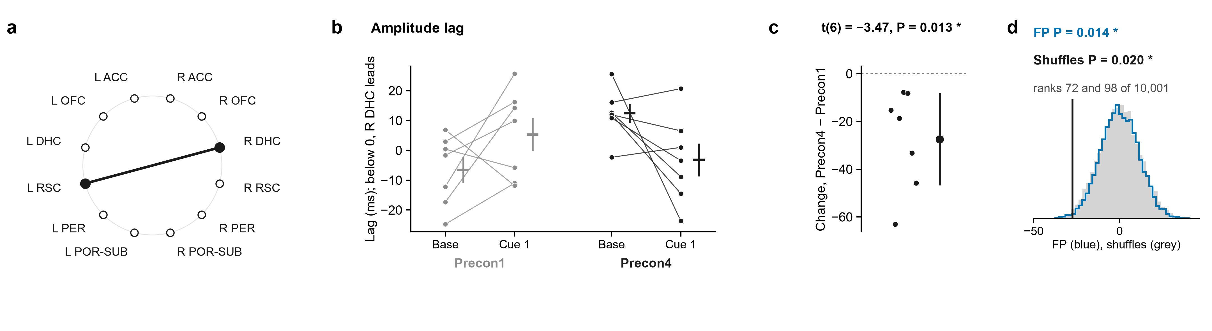
4.2 · R DHC – L RSC · Which leads
Gamma-burst lag, R DHC with L RSC: how the cue shifted it differs between the days by 27 ms, toward R DHC leading on Precon4 compared with Precon1.
Steady-delay coupling, R ACC with L OFC (PLI): cue − baseline was higher on Precon4 than on Precon1.
FP P = 0.023. Shuffles P = 0.027. t-test P = 0.033 (8 rats). All three tests agree: the strongest lead.
FP P = 0.014. Shuffles P = 0.020. t-test P = 0.013 (7 rats). All three tests agree: the strongest lead.
Coupling with a real delay, R ACC with L OFC (imaginary coherence): cue − baseline was higher on Precon4 than on Precon1.
FP P = 0.008. Shuffles P = 0.012. t-test P = 0.016 (8 rats). All three tests agree: the strongest lead.
Notes:
Baseline (10 s) → cue 1 · followed up from the gamma coherence of R DHC – L RSC: direction. a, the pair on the ring of regions. Then, for each measure: its value for each rat at Baseline (10 s) and Cue 1 on Precon1 (grey) and Precon4 (black), each rat's two windows joined, the mean ± s.e.m. beside them; each rat's change between the days, (Precon4 Cue 1 − Baseline (10 s)) − (Precon1 Cue 1 − Baseline (10 s)), with the mean ± 95% confidence interval; and that mean against 10,000 shuffles in which each session's trials had their two windows swapped at random (grey) and against 10,000 sets of fake trials from the same rats' FP1 and FP2, where there were no cues, each session as many as it had real trials, in random order, losing the windows its real trials lost (blue). The pair was followed up because its own change in coherence had P < 0.05 (uncorrected; no pair survives correction on its own), and of the measures run on it these are the ones whose t-test had P < 0.05: they are leads, chosen by that test. Amplitude lag: FP intervals P = 0.014, rank 72 of 10,001; within-session shuffles P = 0.020, rank 98 of 10,001; t(6) = −3.47, P = 0.013 (one-sample t-test of each rat's change, uncorrected).

Slide 89
4.2 · R DHC – L RSC · Which leads
Gamma-burst lag, R DHC with L RSC: how the cue shifted it differs between the days by 27 ms, toward R DHC leading on Precon4 compared with Precon1.
L OFC and L ACC gamma bursts rising together (amplitude correlation): cue − baseline was higher on Precon4 than on Precon1.
FP P = 0.014. Shuffles P = 0.020. t-test P = 0.013 (7 rats). All three tests agree: the strongest lead.
Notes:
FP: rank 72 of 10001, P = 0.014. Shuffles: rank 98 of 10001, P = 0.020. t(6) = -3.47, P = 0.013; mean change -27.44.

Slide 90
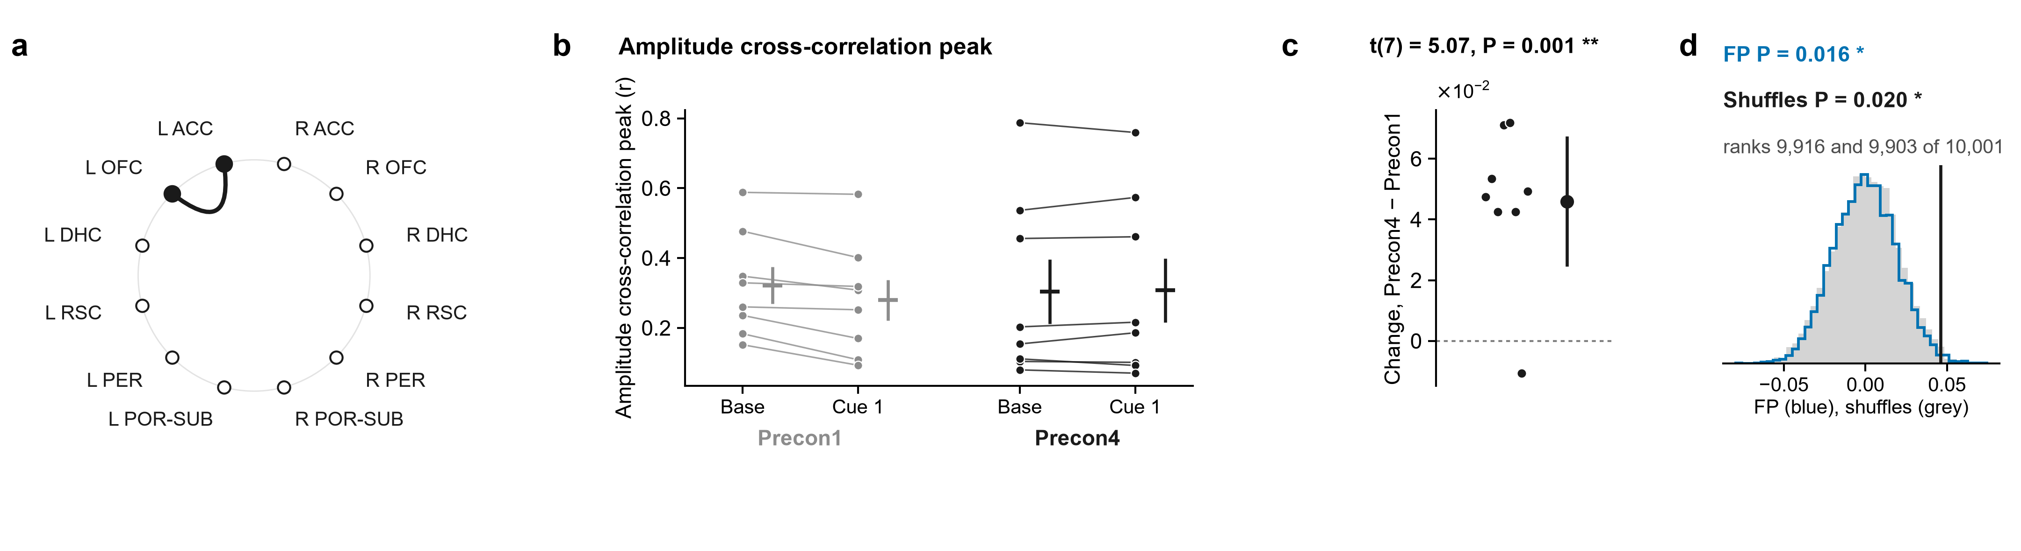
4.3 · L OFC – L ACC · Bursts rise together
L OFC and L ACC gamma bursts rising together (amplitude correlation): cue − baseline was higher on Precon4 than on Precon1.
Gamma-burst lag, R DHC with L RSC: how the cue shifted it differs between the days by 27 ms, toward R DHC leading on Precon4 compared with Precon1.
FP P = 0.016. Shuffles P = 0.020. t-test P = 0.001 (8 rats). All three tests agree: the strongest lead.
FP P = 0.014. Shuffles P = 0.020. t-test P = 0.013 (7 rats). All three tests agree: the strongest lead.
Notes:
Baseline (10 s) → cue 1 · followed up from the gamma coherence of L OFC – L ACC: amplitudes together. a, the pair on the ring of regions. Then, for each measure: its value for each rat at Baseline (10 s) and Cue 1 on Precon1 (grey) and Precon4 (black), each rat's two windows joined, the mean ± s.e.m. beside them; each rat's change between the days, (Precon4 Cue 1 − Baseline (10 s)) − (Precon1 Cue 1 − Baseline (10 s)), with the mean ± 95% confidence interval; and that mean against 10,000 shuffles in which each session's trials had their two windows swapped at random (grey) and against 10,000 sets of fake trials from the same rats' FP1 and FP2, where there were no cues, each session as many as it had real trials, in random order, losing the windows its real trials lost (blue). The pair was followed up because its own change in coherence had P < 0.05 (uncorrected; no pair survives correction on its own), and of the measures run on it these are the ones whose t-test had P < 0.05: they are leads, chosen by that test. Amplitude cross-correlation peak: FP intervals P = 0.016, rank 9,916 of 10,001; within-session shuffles P = 0.020, rank 9,903 of 10,001; t(7) = 5.07, P = 0.001 (one-sample t-test of each rat's change, uncorrected).

Slide 91
4.3 · L OFC – L ACC · Bursts rise together
L OFC and L ACC gamma bursts rising together (amplitude correlation): cue − baseline was higher on Precon4 than on Precon1.
R ACC and L RSC gamma bursts rising together (amplitude correlation): cue − baseline was higher on Precon4 than on Precon1.
FP P = 0.016. Shuffles P = 0.020. t-test P = 0.001 (8 rats). All three tests agree: the strongest lead.
Notes:
FP: rank 9916 of 10001, P = 0.016. Shuffles: rank 9903 of 10001, P = 0.020. t(7) = 5.07, P = 0.001; mean change 0.04594.

Slide 92
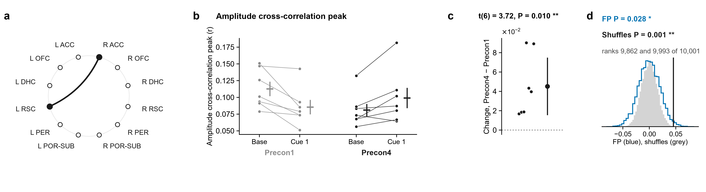
4.4 · R ACC – L RSC · Bursts rise together
R ACC and L RSC gamma bursts rising together (amplitude correlation): cue − baseline was higher on Precon4 than on Precon1.
L OFC and L ACC gamma bursts rising together (amplitude correlation): cue − baseline was higher on Precon4 than on Precon1.
FP P = 0.028. Shuffles P = 0.001. t-test P = 0.010 (7 rats). All three tests agree: the strongest lead.
FP P = 0.016. Shuffles P = 0.020. t-test P = 0.001 (8 rats). All three tests agree: the strongest lead.
Notes:
Baseline (10 s) → cue 1 · followed up from the gamma coherence of R ACC – L RSC: amplitudes together. a, the pair on the ring of regions. Then, for each measure: its value for each rat at Baseline (10 s) and Cue 1 on Precon1 (grey) and Precon4 (black), each rat's two windows joined, the mean ± s.e.m. beside them; each rat's change between the days, (Precon4 Cue 1 − Baseline (10 s)) − (Precon1 Cue 1 − Baseline (10 s)), with the mean ± 95% confidence interval; and that mean against 10,000 shuffles in which each session's trials had their two windows swapped at random (grey) and against 10,000 sets of fake trials from the same rats' FP1 and FP2, where there were no cues, each session as many as it had real trials, in random order, losing the windows its real trials lost (blue). The pair was followed up because its own change in coherence had P < 0.05 (uncorrected; no pair survives correction on its own), and of the measures run on it these are the ones whose t-test had P < 0.05: they are leads, chosen by that test. Amplitude cross-correlation peak: FP intervals P = 0.028, rank 9,862 of 10,001; within-session shuffles P = 0.001, rank 9,993 of 10,001; t(6) = 3.72, P = 0.010 (one-sample t-test of each rat's change, uncorrected).

Slide 93
4.4 · R ACC – L RSC · Bursts rise together
R ACC and L RSC gamma bursts rising together (amplitude correlation): cue − baseline was higher on Precon4 than on Precon1.
R ACC and R OFC gamma bursts rising together (amplitude correlation): cue − baseline was higher on Precon4 than on Precon1.
FP P = 0.028. Shuffles P = 0.001. t-test P = 0.010 (7 rats). All three tests agree: the strongest lead.
Notes:
FP: rank 9862 of 10001, P = 0.028. Shuffles: rank 9993 of 10001, P = 0.001. t(6) = 3.72, P = 0.010; mean change 0.04523.

Slide 94
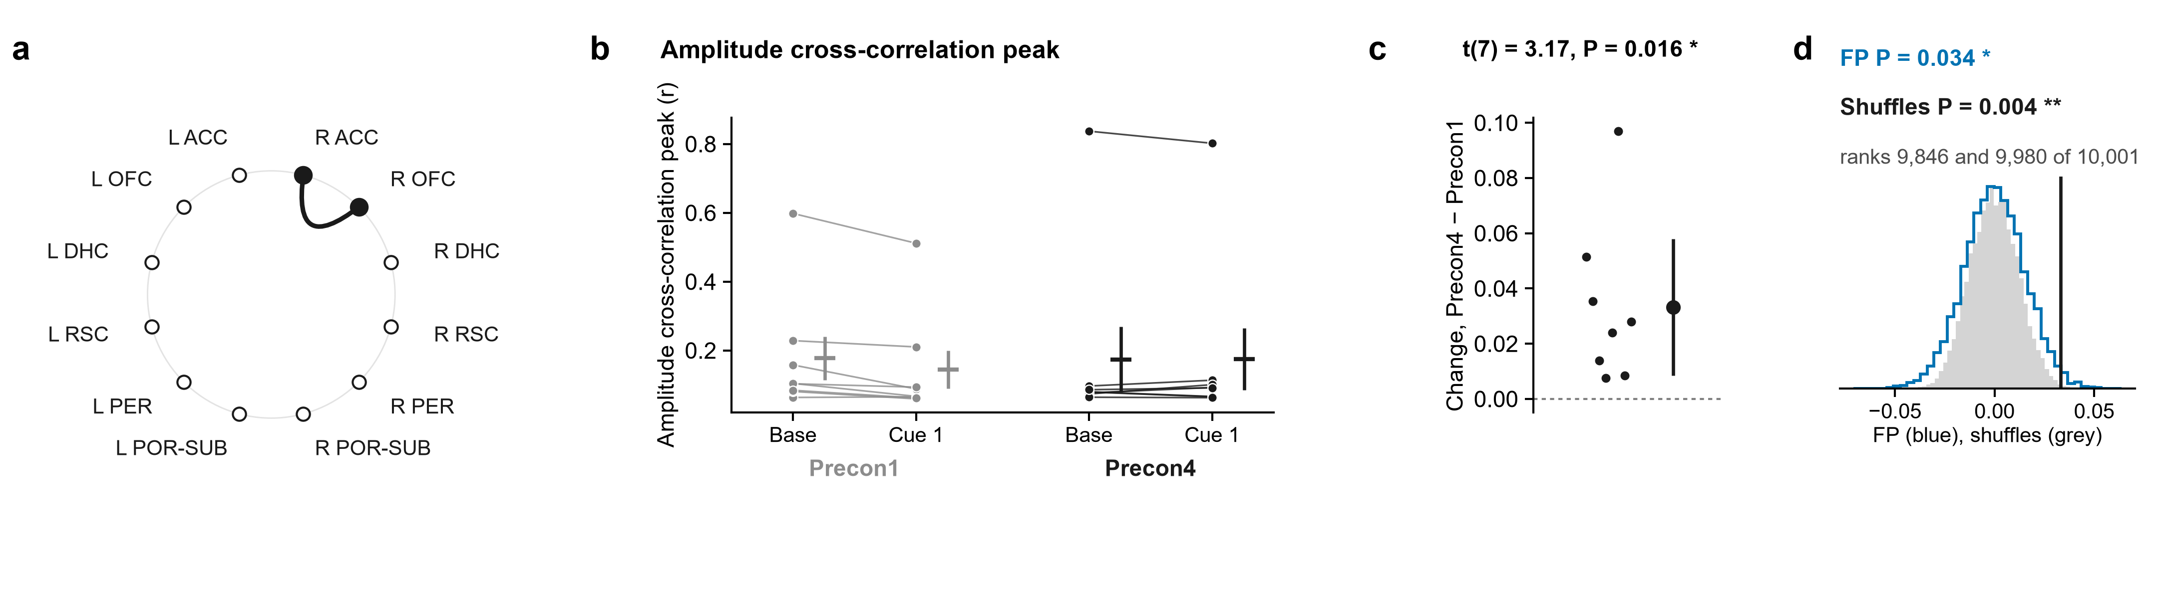
4.5 · R ACC – R OFC · Bursts rise together
R ACC and R OFC gamma bursts rising together (amplitude correlation): cue − baseline was higher on Precon4 than on Precon1.
R ACC and L RSC gamma bursts rising together (amplitude correlation): cue − baseline was higher on Precon4 than on Precon1.
FP P = 0.034. Shuffles P = 0.004. t-test P = 0.016 (8 rats). All three tests agree: the strongest lead.
FP P = 0.028. Shuffles P = 0.001. t-test P = 0.010 (7 rats). All three tests agree: the strongest lead.
Notes:
Baseline (10 s) → cue 1 · followed up from the gamma coherence of R ACC – R OFC: amplitudes together. a, the pair on the ring of regions. Then, for each measure: its value for each rat at Baseline (10 s) and Cue 1 on Precon1 (grey) and Precon4 (black), each rat's two windows joined, the mean ± s.e.m. beside them; each rat's change between the days, (Precon4 Cue 1 − Baseline (10 s)) − (Precon1 Cue 1 − Baseline (10 s)), with the mean ± 95% confidence interval; and that mean against 10,000 shuffles in which each session's trials had their two windows swapped at random (grey) and against 10,000 sets of fake trials from the same rats' FP1 and FP2, where there were no cues, each session as many as it had real trials, in random order, losing the windows its real trials lost (blue). The pair was followed up because its own change in coherence had P < 0.05 (uncorrected; no pair survives correction on its own), and of the measures run on it these are the ones whose t-test had P < 0.05: they are leads, chosen by that test. Amplitude cross-correlation peak: FP intervals P = 0.034, rank 9,846 of 10,001; within-session shuffles P = 0.004, rank 9,980 of 10,001; t(7) = 3.17, P = 0.016 (one-sample t-test of each rat's change, uncorrected).

Slide 95
4.5 · R ACC – R OFC · Bursts rise together
R ACC and R OFC gamma bursts rising together (amplitude correlation): cue − baseline was higher on Precon4 than on Precon1.
L ACC predicting L RSC (Granger L ACC → L RSC): cue − baseline was higher on Precon4 than on Precon1.
FP P = 0.034. Shuffles P = 0.004. t-test P = 0.016 (8 rats). All three tests agree: the strongest lead.
Notes:
FP: rank 9846 of 10001, P = 0.034. Shuffles: rank 9980 of 10001, P = 0.004. t(7) = 3.17, P = 0.016; mean change 0.03322.

Slide 96
4.6 · L RSC – L ACC · Which leads
L ACC predicting L RSC (Granger L ACC → L RSC): cue − baseline was higher on Precon4 than on Precon1.
R ACC and R OFC gamma bursts rising together (amplitude correlation): cue − baseline was higher on Precon4 than on Precon1.
FP P = 0.040. Shuffles P = 0.008. t-test P = 0.030 (7 rats). All three tests agree: the strongest lead.
FP P = 0.034. Shuffles P = 0.004. t-test P = 0.016 (8 rats). All three tests agree: the strongest lead.
Notes:
Baseline (10 s) → cue 1 · followed up from the gamma coherence of L RSC – L ACC: direction. a, the pair on the ring of regions (the arrow, the direction measured). Then, for each measure: its value for each rat at Baseline (10 s) and Cue 1 on Precon1 (grey) and Precon4 (black), each rat's two windows joined, the mean ± s.e.m. beside them; each rat's change between the days, (Precon4 Cue 1 − Baseline (10 s)) − (Precon1 Cue 1 − Baseline (10 s)), with the mean ± 95% confidence interval; and that mean against 10,000 shuffles in which each session's trials had their two windows swapped at random (grey) and against 10,000 sets of fake trials from the same rats' FP1 and FP2, where there were no cues, each session as many as it had real trials, in random order, losing the windows its real trials lost (blue). The pair was followed up because its own change in coherence had P < 0.05 (uncorrected; no pair survives correction on its own), and of the measures run on it these are the ones whose t-test had P < 0.05: they are leads, chosen by that test. Granger L ACC → L RSC: FP intervals P = 0.040, rank 9,793 of 10,001; within-session shuffles P = 0.008, rank 9,955 of 10,001; t(6) = 2.82, P = 0.030 (one-sample t-test of each rat's change, uncorrected).

Slide 97
4.6 · L RSC – L ACC · Which leads
L ACC predicting L RSC (Granger L ACC → L RSC): cue − baseline was higher on Precon4 than on Precon1.
R DHC and L OFC gamma bursts rising together (amplitude correlation): cue − baseline was higher on Precon4 than on Precon1.
FP P = 0.040. Shuffles P = 0.008. t-test P = 0.030 (7 rats). All three tests agree: the strongest lead.
Notes:
FP: rank 9793 of 10001, P = 0.040. Shuffles: rank 9955 of 10001, P = 0.008. t(6) = 2.82, P = 0.030; mean change 0.008396.

Slide 98
4.7 · R DHC – L OFC · Bursts rise together
R DHC and L OFC gamma bursts rising together (amplitude correlation): cue − baseline was higher on Precon4 than on Precon1.
L ACC predicting L RSC (Granger L ACC → L RSC): cue − baseline was higher on Precon4 than on Precon1.
FP P = 0.040. Shuffles P = 0.008. t-test P = 0.030 (7 rats). All three tests agree: the strongest lead.
FP P = 0.027. Shuffles P = 0.082. t-test P = 0.018 (8 rats). Two of the three agree: a middling lead.
Notes:
Baseline (10 s) → cue 1 · followed up from the gamma coherence of R DHC – L OFC: amplitudes together. a, the pair on the ring of regions. Then, for each measure: its value for each rat at Baseline (10 s) and Cue 1 on Precon1 (grey) and Precon4 (black), each rat's two windows joined, the mean ± s.e.m. beside them; each rat's change between the days, (Precon4 Cue 1 − Baseline (10 s)) − (Precon1 Cue 1 − Baseline (10 s)), with the mean ± 95% confidence interval; and that mean against 10,000 shuffles in which each session's trials had their two windows swapped at random (grey) and against 10,000 sets of fake trials from the same rats' FP1 and FP2, where there were no cues, each session as many as it had real trials, in random order, losing the windows its real trials lost (blue). The pair was followed up because its own change in coherence had P < 0.05 (uncorrected; no pair survives correction on its own), and of the measures run on it these are the ones whose t-test had P < 0.05: they are leads, chosen by that test. Amplitude cross-correlation peak: FP intervals P = 0.027, rank 9,865 of 10,001; within-session shuffles P = 0.082, rank 9,567 of 10,001; t(7) = 3.09, P = 0.018 (one-sample t-test of each rat's change, uncorrected).

Slide 99
4.7 · R DHC – L OFC · Bursts rise together
R DHC and L OFC gamma bursts rising together (amplitude correlation): cue − baseline was higher on Precon4 than on Precon1.
Theta in R DHC pacing gamma in L OFC (PAC): cue − baseline was higher on Precon4 than on Precon1.
FP P = 0.027. Shuffles P = 0.082. t-test P = 0.018 (8 rats). Two of the three agree: a middling lead.
Notes:
FP: rank 9865 of 10001, P = 0.027. Shuffles: rank 9567 of 10001, P = 0.082. t(7) = 3.09, P = 0.018; mean change 0.03085.

Slide 100
4.8 · R DHC – L OFC · Theta paces gamma
Theta in R DHC pacing gamma in L OFC (PAC): cue − baseline was higher on Precon4 than on Precon1.
R DHC and L OFC gamma bursts rising together (amplitude correlation): cue − baseline was higher on Precon4 than on Precon1.
FP P = 0.029. Shuffles P = 0.103. t-test P = 0.039 (8 rats). Two of the three agree: a middling lead.
FP P = 0.027. Shuffles P = 0.082. t-test P = 0.018 (8 rats). Two of the three agree: a middling lead.
Notes:
Baseline (10 s) → cue 1 · followed up from the gamma coherence of R DHC – L OFC: theta–gamma coupling, R DHC θ → L OFC γ. a, the pair on the ring of regions (the arrow, the direction measured). Then, for each measure: its value for each rat at Baseline (10 s) and Cue 1 on Precon1 (grey) and Precon4 (black), each rat's values as dots (PAC is never drawn as lines), the mean ± s.e.m. beside them; each rat's change between the days, (Precon4 Cue 1 − Baseline (10 s)) − (Precon1 Cue 1 − Baseline (10 s)), with the mean ± 95% confidence interval; and that mean against 10,000 shuffles in which each session's trials had their two windows swapped at random (grey) and against 10,000 sets of fake trials from the same rats' FP1 and FP2, where there were no cues, each session as many as it had real trials, in random order, losing the windows its real trials lost (blue). The pair was followed up because its own change in coherence had P < 0.05 (uncorrected; no pair survives correction on its own), and of the measures run on it these are the ones whose t-test had P < 0.05: they are leads, chosen by that test. PAC is Tort's modulation index (18 theta-phase bins) of gamma (30–90 Hz) amplitude over theta (5–12 Hz) phase, computed over each trial's whole window (the whole baseline, or the whole cue window), then averaged over the session's trials: a dot is one rat. The roses are the same windows' gamma amplitude in each theta-phase bin, normalised, averaged over the trials and then the rats; the comodulogram is the change in cue effect in narrow theta (2 Hz) and gamma (10 Hz) bands. PAC R DHC θ → L OFC γ: FP intervals P = 0.029, rank 9,858 of 10,001; within-session shuffles P = 0.103, rank 9,485 of 10,001; t(7) = 2.54, P = 0.039 (one-sample t-test of each rat's change, uncorrected).

Slide 101
4.8 · R DHC – L OFC · Theta paces gamma
Theta in R DHC pacing gamma in L OFC (PAC): cue − baseline was higher on Precon4 than on Precon1.
Its roses: L OFC gamma around the R DHC theta cycle, averaged over trials and rats, Precon1 then Precon4. Where in the cycle, not how much: c is the result.
FP P = 0.029. Shuffles P = 0.103. t-test P = 0.039 (8 rats). Two of the three agree: a middling lead.
Notes:
FP: rank 9858 of 10001, P = 0.029. Shuffles: rank 9485 of 10001, P = 0.103. t(7) = 2.54, P = 0.039; mean change 0.00015.

Slide 102
4.8 · R DHC – L OFC · Theta paces gamma
Its roses: L OFC gamma around the R DHC theta cycle, averaged over trials and rats, Precon1 then Precon4. Where in the cycle, not how much: c is the result.
Coupling with a real delay, R ACC with R RSC (imaginary coherence): cue − baseline was higher on Precon4 than on Precon1.
Theta in R DHC pacing gamma in L OFC (PAC): cue − baseline was higher on Precon4 than on Precon1.
FP P = 0.029. Shuffles P = 0.103. t-test P = 0.039 (8 rats). Two of the three agree: a middling lead.

Slide 103
4.9 · R ACC – R RSC · Not just a shared signal
Coupling with a real delay, R ACC with R RSC (imaginary coherence): cue − baseline was higher on Precon4 than on Precon1.
Its roses: L OFC gamma around the R DHC theta cycle, averaged over trials and rats, Precon1 then Precon4. Where in the cycle, not how much: c is the result.
FP P = 0.042. Shuffles P = 0.058. t-test P < 0.001 (6 rats). Two of the three agree: a middling lead.
Notes:
Baseline (10 s) → cue 1 · followed up from the gamma coherence of R ACC – R RSC: not volume conduction. a, the pair on the ring of regions. Then, for each measure: its value for each rat at Baseline (10 s) and Cue 1 on Precon1 (grey) and Precon4 (black), each rat's two windows joined, the mean ± s.e.m. beside them; each rat's change between the days, (Precon4 Cue 1 − Baseline (10 s)) − (Precon1 Cue 1 − Baseline (10 s)), with the mean ± 95% confidence interval; and that mean against 10,000 shuffles in which each session's trials had their two windows swapped at random (grey) and against 10,000 sets of fake trials from the same rats' FP1 and FP2, where there were no cues, each session as many as it had real trials, in random order, losing the windows its real trials lost (blue). The pair was followed up because its own change in coherence had P < 0.05 (uncorrected; no pair survives correction on its own), and of the measures run on it these are the ones whose t-test had P < 0.05: they are leads, chosen by that test. Imaginary coherence: FP intervals P = 0.042, rank 9,796 of 10,001; within-session shuffles P = 0.058, rank 9,721 of 10,001; t(5) = 7.13, P < 0.001 (one-sample t-test of each rat's change, uncorrected).

Slide 104
4.9 · R ACC – R RSC · Not just a shared signal
Coupling with a real delay, R ACC with R RSC (imaginary coherence): cue − baseline was higher on Precon4 than on Precon1.
R ACC and L ACC gamma bursts rising together (amplitude correlation): cue − baseline was higher on Precon4 than on Precon1.
FP P = 0.042. Shuffles P = 0.058. t-test P < 0.001 (6 rats). Two of the three agree: a middling lead.
Notes:
FP: rank 9796 of 10001, P = 0.042. Shuffles: rank 9721 of 10001, P = 0.058. t(5) = 7.13, P < 0.001; mean change 0.01537.

Slide 105
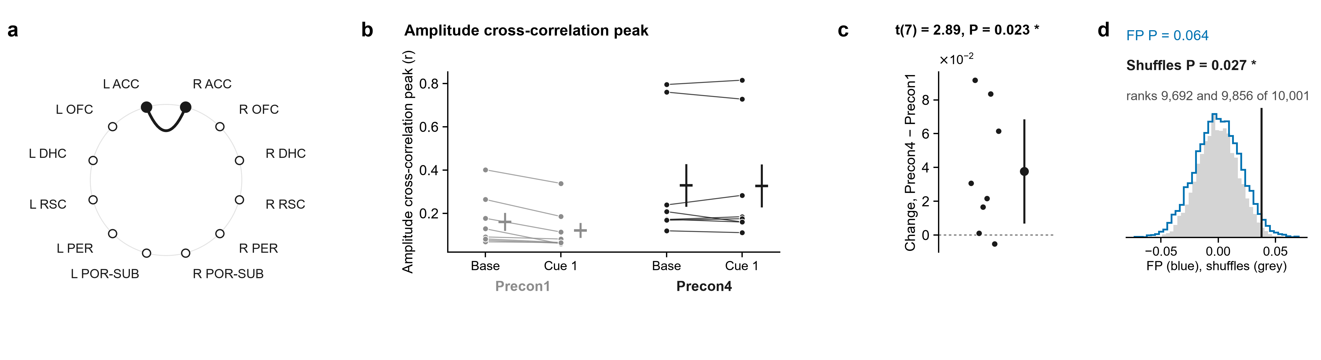
4.10 · R ACC – L ACC · Bursts rise together
R ACC and L ACC gamma bursts rising together (amplitude correlation): cue − baseline was higher on Precon4 than on Precon1.
Coupling with a real delay, R ACC with R RSC (imaginary coherence): cue − baseline was higher on Precon4 than on Precon1.
FP P = 0.064. Shuffles P = 0.027. t-test P = 0.023 (8 rats). Two of the three agree: a middling lead.
FP P = 0.042. Shuffles P = 0.058. t-test P < 0.001 (6 rats). Two of the three agree: a middling lead.
Notes:
Baseline (10 s) → cue 1 · followed up from the gamma coherence of R ACC – L ACC: amplitudes together. a, the pair on the ring of regions. Then, for each measure: its value for each rat at Baseline (10 s) and Cue 1 on Precon1 (grey) and Precon4 (black), each rat's two windows joined, the mean ± s.e.m. beside them; each rat's change between the days, (Precon4 Cue 1 − Baseline (10 s)) − (Precon1 Cue 1 − Baseline (10 s)), with the mean ± 95% confidence interval; and that mean against 10,000 shuffles in which each session's trials had their two windows swapped at random (grey) and against 10,000 sets of fake trials from the same rats' FP1 and FP2, where there were no cues, each session as many as it had real trials, in random order, losing the windows its real trials lost (blue). The pair was followed up because its own change in coherence had P < 0.05 (uncorrected; no pair survives correction on its own), and of the measures run on it these are the ones whose t-test had P < 0.05: they are leads, chosen by that test. Amplitude cross-correlation peak: FP intervals P = 0.064, rank 9,692 of 10,001; within-session shuffles P = 0.027, rank 9,856 of 10,001; t(7) = 2.89, P = 0.023 (one-sample t-test of each rat's change, uncorrected).

Slide 106
4.10 · R ACC – L ACC · Bursts rise together
R ACC and L ACC gamma bursts rising together (amplitude correlation): cue − baseline was higher on Precon4 than on Precon1.
Coupling with a real delay, R ACC with L ACC (imaginary coherence): cue − baseline was higher on Precon4 than on Precon1.
FP P = 0.064. Shuffles P = 0.027. t-test P = 0.023 (8 rats). Two of the three agree: a middling lead.
Notes:
FP: rank 9692 of 10001, P = 0.064. Shuffles: rank 9856 of 10001, P = 0.027. t(7) = 2.89, P = 0.023; mean change 0.03769.

Slide 107
4.11 · R ACC – L ACC · Not just a shared signal
Coupling with a real delay, R ACC with L ACC (imaginary coherence): cue − baseline was higher on Precon4 than on Precon1.
R ACC and L ACC gamma bursts rising together (amplitude correlation): cue − baseline was higher on Precon4 than on Precon1.
FP P = 0.064. Shuffles P = 0.077. t-test P = 0.027 (8 rats). One test only: a weaker lead.
FP P = 0.064. Shuffles P = 0.027. t-test P = 0.023 (8 rats). Two of the three agree: a middling lead.
Notes:
Baseline (10 s) → cue 1 · followed up from the gamma coherence of R ACC – L ACC: not volume conduction. a, the pair on the ring of regions. Then, for each measure: its value for each rat at Baseline (10 s) and Cue 1 on Precon1 (grey) and Precon4 (black), each rat's two windows joined, the mean ± s.e.m. beside them; each rat's change between the days, (Precon4 Cue 1 − Baseline (10 s)) − (Precon1 Cue 1 − Baseline (10 s)), with the mean ± 95% confidence interval; and that mean against 10,000 shuffles in which each session's trials had their two windows swapped at random (grey) and against 10,000 sets of fake trials from the same rats' FP1 and FP2, where there were no cues, each session as many as it had real trials, in random order, losing the windows its real trials lost (blue). The pair was followed up because its own change in coherence had P < 0.05 (uncorrected; no pair survives correction on its own), and of the measures run on it these are the ones whose t-test had P < 0.05: they are leads, chosen by that test. Imaginary coherence: FP intervals P = 0.064, rank 9,664 of 10,001; within-session shuffles P = 0.077, rank 9,635 of 10,001; t(7) = 2.78, P = 0.027 (one-sample t-test of each rat's change, uncorrected).

Slide 108
4.11 · R ACC – L ACC · Not just a shared signal
Coupling with a real delay, R ACC with L ACC (imaginary coherence): cue − baseline was higher on Precon4 than on Precon1.
Theta in R ACC pacing gamma in L OFC (PAC): cue − baseline was higher on Precon4 than on Precon1.
FP P = 0.064. Shuffles P = 0.077. t-test P = 0.027 (8 rats). One test only: a weaker lead.
Notes:
FP: rank 9664 of 10001, P = 0.064. Shuffles: rank 9635 of 10001, P = 0.077. t(7) = 2.78, P = 0.027; mean change 0.01397.

Slide 109
4.12 · R ACC – L OFC · Theta paces gamma
Theta in R ACC pacing gamma in L OFC (PAC): cue − baseline was higher on Precon4 than on Precon1.
Coupling with a real delay, R ACC with L ACC (imaginary coherence): cue − baseline was higher on Precon4 than on Precon1.
FP P = 0.179. Shuffles P = 0.187. t-test P = 0.010 (8 rats). One test only: a weaker lead.
FP P = 0.064. Shuffles P = 0.077. t-test P = 0.027 (8 rats). One test only: a weaker lead.
Notes:
Baseline (10 s) → cue 1 · followed up from the gamma coherence of R ACC – L OFC: theta–gamma coupling, R ACC θ → L OFC γ. a, the pair on the ring of regions (the arrow, the direction measured). Then, for each measure: its value for each rat at Baseline (10 s) and Cue 1 on Precon1 (grey) and Precon4 (black), each rat's values as dots (PAC is never drawn as lines), the mean ± s.e.m. beside them; each rat's change between the days, (Precon4 Cue 1 − Baseline (10 s)) − (Precon1 Cue 1 − Baseline (10 s)), with the mean ± 95% confidence interval; and that mean against 10,000 shuffles in which each session's trials had their two windows swapped at random (grey) and against 10,000 sets of fake trials from the same rats' FP1 and FP2, where there were no cues, each session as many as it had real trials, in random order, losing the windows its real trials lost (blue). The pair was followed up because its own change in coherence had P < 0.05 (uncorrected; no pair survives correction on its own), and of the measures run on it these are the ones whose t-test had P < 0.05: they are leads, chosen by that test. PAC is Tort's modulation index (18 theta-phase bins) of gamma (30–90 Hz) amplitude over theta (5–12 Hz) phase, computed over each trial's whole window (the whole baseline, or the whole cue window), then averaged over the session's trials: a dot is one rat. The roses are the same windows' gamma amplitude in each theta-phase bin, normalised, averaged over the trials and then the rats; the comodulogram is the change in cue effect in narrow theta (2 Hz) and gamma (10 Hz) bands. PAC R ACC θ → L OFC γ: FP intervals P = 0.179, rank 9,126 of 10,001; within-session shuffles P = 0.187, rank 9,004 of 10,001; t(7) = 3.53, P = 0.010 (one-sample t-test of each rat's change, uncorrected).

Slide 110
4.12 · R ACC – L OFC · Theta paces gamma
Theta in R ACC pacing gamma in L OFC (PAC): cue − baseline was higher on Precon4 than on Precon1.
Its roses: L OFC gamma around the R ACC theta cycle, averaged over trials and rats, Precon1 then Precon4. Where in the cycle, not how much: c is the result.
FP P = 0.179. Shuffles P = 0.187. t-test P = 0.010 (8 rats). One test only: a weaker lead.
Notes:
FP: rank 9126 of 10001, P = 0.179. Shuffles: rank 9004 of 10001, P = 0.187. t(7) = 3.53, P = 0.010; mean change 9.734e-05.

Slide 111
4.12 · R ACC – L OFC · Theta paces gamma
Its roses: L OFC gamma around the R ACC theta cycle, averaged over trials and rats, Precon1 then Precon4. Where in the cycle, not how much: c is the result.
Theta in L RSC pacing gamma in R OFC (PAC): cue − baseline was higher on Precon4 than on Precon1.
Theta in R ACC pacing gamma in L OFC (PAC): cue − baseline was higher on Precon4 than on Precon1.
FP P = 0.179. Shuffles P = 0.187. t-test P = 0.010 (8 rats). One test only: a weaker lead.

Slide 112
4.13 · R OFC – L RSC · Theta paces gamma
Theta in L RSC pacing gamma in R OFC (PAC): cue − baseline was higher on Precon4 than on Precon1.
Its roses: L OFC gamma around the R ACC theta cycle, averaged over trials and rats, Precon1 then Precon4. Where in the cycle, not how much: c is the result.
FP P = 0.298. Shuffles P = 0.135. t-test P = 0.020 (7 rats). One test only: a weaker lead.
Notes:
Baseline (10 s) → cue 1 · followed up from the gamma coherence of R OFC – L RSC: theta–gamma coupling, L RSC θ → R OFC γ. a, the pair on the ring of regions (the arrow, the direction measured). Then, for each measure: its value for each rat at Baseline (10 s) and Cue 1 on Precon1 (grey) and Precon4 (black), each rat's values as dots (PAC is never drawn as lines), the mean ± s.e.m. beside them; each rat's change between the days, (Precon4 Cue 1 − Baseline (10 s)) − (Precon1 Cue 1 − Baseline (10 s)), with the mean ± 95% confidence interval; and that mean against 10,000 shuffles in which each session's trials had their two windows swapped at random (grey) and against 10,000 sets of fake trials from the same rats' FP1 and FP2, where there were no cues, each session as many as it had real trials, in random order, losing the windows its real trials lost (blue). The pair was followed up because its own change in coherence had P < 0.05 (uncorrected; no pair survives correction on its own), and of the measures run on it these are the ones whose t-test had P < 0.05: they are leads, chosen by that test. PAC is Tort's modulation index (18 theta-phase bins) of gamma (30–90 Hz) amplitude over theta (5–12 Hz) phase, computed over each trial's whole window (the whole baseline, or the whole cue window), then averaged over the session's trials: a dot is one rat. The roses are the same windows' gamma amplitude in each theta-phase bin, normalised, averaged over the trials and then the rats; the comodulogram is the change in cue effect in narrow theta (2 Hz) and gamma (10 Hz) bands. PAC L RSC θ → R OFC γ: FP intervals P = 0.298, rank 8,472 of 10,001; within-session shuffles P = 0.135, rank 9,285 of 10,001; t(6) = 3.13, P = 0.020 (one-sample t-test of each rat's change, uncorrected).

Slide 113
4.13 · R OFC – L RSC · Theta paces gamma
Theta in L RSC pacing gamma in R OFC (PAC): cue − baseline was higher on Precon4 than on Precon1.
Its roses: R OFC gamma around the L RSC theta cycle, averaged over trials and rats, Precon1 then Precon4. Where in the cycle, not how much: c is the result.
FP P = 0.298. Shuffles P = 0.135. t-test P = 0.020 (7 rats). One test only: a weaker lead.
Notes:
FP: rank 8472 of 10001, P = 0.298. Shuffles: rank 9285 of 10001, P = 0.135. t(6) = 3.13, P = 0.020; mean change 9.774e-05.

Slide 114
4.13 · R OFC – L RSC · Theta paces gamma
Its roses: R OFC gamma around the L RSC theta cycle, averaged over trials and rats, Precon1 then Precon4. Where in the cycle, not how much: c is the result.
From Precon1 to Precon4 the cues’ effect on gamma coherence swung across the network: on Precon1 they lowered it in 31 of 44 pairs; on Precon4, about even (23 up, 21 down).
Theta in L RSC pacing gamma in R OFC (PAC): cue − baseline was higher on Precon4 than on Precon1.
FP P = 0.298. Shuffles P = 0.135. t-test P = 0.020 (7 rats). One test only: a weaker lead.

Slide 115
What it adds up to
From Precon1 to Precon4 the cues’ effect on gamma coherence swung across the network: on Precon1 they lowered it in 31 of 44 pairs; on Precon4, about even (23 up, 21 down).
Its roses: R OFC gamma around the L RSC theta cycle, averaged over trials and rats, Precon1 then Precon4. Where in the cycle, not how much: c is the result.
Figure 2 (both cues): the rats agreed on that swing (increases P = 0.012), but FP and the shuffles do not confirm it.

Slide 116
What it adds up to
From Precon1 to Precon4 the cues’ effect on gamma coherence swung across the network: on Precon1 they lowered it in 31 of 44 pairs; on Precon4, about even (23 up, 21 down).
Figure 2 (both cues): the rats agreed on that swing (increases P = 0.012), but FP and the shuffles do not confirm it.
Figure 4 (cue 1): the increases pass every test (FP P = 0.037, shuffles P = 0.030, rats’ flips P = 0.027).

Slide 117
What it adds up to
From Precon1 to Precon4 the cues’ effect on gamma coherence swung across the network: on Precon1 they lowered it in 31 of 44 pairs; on Precon4, about even (23 up, 21 down).
Figure 2 (both cues): the rats agreed on that swing (increases P = 0.012), but FP and the shuffles do not confirm it.
Figure 4 (cue 1): the increases pass every test (FP P = 0.037, shuffles P = 0.030, rats’ flips P = 0.027).
The change in cue effect passes no test in Figures 1, 3, 5, 6 (theta, and cue 1 → cue 2). In theta, some single days’ cue effects stand out of FP (Figures 1, 3, 5): the cues move theta, but no differently on Precon4 than on Precon1.

Slide 118
What it adds up to
From Precon1 to Precon4 the cues’ effect on gamma coherence swung across the network: on Precon1 they lowered it in 31 of 44 pairs; on Precon4, about even (23 up, 21 down).
Of the 20 follow-up figures, 9 pass all three tests (2.1, 2.2, 2.3, 4.1, 4.2, 4.3, 4.4, 4.5, 4.6), 5 pass two (2.4, 4.7, 4.8, 4.9, 4.10), the rest only the t-test. They were picked from 190 t-tests, 21 of which passed where about 10 would by chance.
Figure 2 (both cues): the rats agreed on that swing (increases P = 0.012), but FP and the shuffles do not confirm it.
Figure 4 (cue 1): the increases pass every test (FP P = 0.037, shuffles P = 0.030, rats’ flips P = 0.027).
The change in cue effect passes no test in Figures 1, 3, 5, 6 (theta, and cue 1 → cue 2). In theta, some single days’ cue effects stand out of FP (Figures 1, 3, 5): the cues move theta, but no differently on Precon4 than on Precon1.

Slide 119
What it adds up to
Of the 20 follow-up figures, 9 pass all three tests (2.1, 2.2, 2.3, 4.1, 4.2, 4.3, 4.4, 4.5, 4.6), 5 pass two (2.4, 4.7, 4.8, 4.9, 4.10), the rest only the t-test. They were picked from 190 t-tests, 21 of which passed where about 10 would by chance.
From Precon1 to Precon4 the cues’ effect on gamma coherence swung across the network: on Precon1 they lowered it in 31 of 44 pairs; on Precon4, about even (23 up, 21 down).
Figure 2 (both cues): the rats agreed on that swing (increases P = 0.012), but FP and the shuffles do not confirm it.
FP is the most physiological of the three yardsticks: it carries what these rats’ brains do with no cues, with every session’s own lost windows. A result it passes and the shuffle does not is still worth a second look.
Figure 4 (cue 1): the increases pass every test (FP P = 0.037, shuffles P = 0.030, rats’ flips P = 0.027).
The change in cue effect passes no test in Figures 1, 3, 5, 6 (theta, and cue 1 → cue 2). In theta, some single days’ cue effects stand out of FP (Figures 1, 3, 5): the cues move theta, but no differently on Precon4 than on Precon1.

Slide 120
What it adds up to
Of the 20 follow-up figures, 9 pass all three tests (2.1, 2.2, 2.3, 4.1, 4.2, 4.3, 4.4, 4.5, 4.6), 5 pass two (2.4, 4.7, 4.8, 4.9, 4.10), the rest only the t-test. They were picked from 190 t-tests, 21 of which passed where about 10 would by chance.
FP is the most physiological of the three yardsticks: it carries what these rats’ brains do with no cues, with every session’s own lost windows. A result it passes and the shuffle does not is still worth a second look.
Nothing is corrected across tests, and the rings re-test the data that lit the light. All of this is leads to test again, not findings yet.

Slide 121
What it adds up to
Of the 20 follow-up figures, 9 pass all three tests (2.1, 2.2, 2.3, 4.1, 4.2, 4.3, 4.4, 4.5, 4.6), 5 pass two (2.4, 4.7, 4.8, 4.9, 4.10), the rest only the t-test. They were picked from 190 t-tests, 21 of which passed where about 10 would by chance.
Everything is in Jarvis: tab 9 has each figure as PDF, SVG and PNG with its legend, and its numbers for Prism (.xlsx and .pzfx); tab 8 has the SPSS files to recreate the lights.
FP is the most physiological of the three yardsticks: it carries what these rats’ brains do with no cues, with every session’s own lost windows. A result it passes and the shuffle does not is still worth a second look.
Nothing is corrected across tests, and the rings re-test the data that lit the light. All of this is leads to test again, not findings yet.

Slide 122
What it adds up to
Everything is in Jarvis: tab 9 has each figure as PDF, SVG and PNG with its legend, and its numbers for Prism (.xlsx and .pzfx); tab 8 has the SPSS files to recreate the lights.
Of the 20 follow-up figures, 9 pass all three tests (2.1, 2.2, 2.3, 4.1, 4.2, 4.3, 4.4, 4.5, 4.6), 5 pass two (2.4, 4.7, 4.8, 4.9, 4.10), the rest only the t-test. They were picked from 190 t-tests, 21 of which passed where about 10 would by chance.
FP is the most physiological of the three yardsticks: it carries what these rats’ brains do with no cues, with every session’s own lost windows. A result it passes and the shuffle does not is still worth a second look.
Nothing is corrected across tests, and the rings re-test the data that lit the light. All of this is leads to test again, not findings yet.
Notes:
Monolith page, tabs 8 (Joe's data) and 9 (Joe's figures). Questions to Shahriar.

